Slide 1

DenseNets Reloaded: Paradigm Shift Beyond ResNets and ViTs
Donghyun Kim*, Byeongho Heo, and Dongyoon Han*
Naver Cloud AI, Naver AI Lab
European Conference on Computer Vision, 2024
Presented by Aditya Bhargava, Alex Darwiche, Cameron Halaby
*Equal Contribution

Slide 2

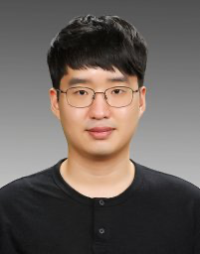
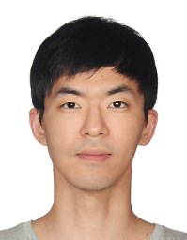
Donghyun Kim*
Machine Learning and OCR¹
Research Engineer at NAVER Cloud¹
Byeongho Heo
Knowledge Distillation, Computer Vision and Machine Learning¹
Research scientist at NAVER AI LAB, NAVER Cloud¹
Dongyoon Han*
Machine Learning, Computer Vision and Natural Language Processing¹
Research Scientist at NAVER AI Lab¹
*Equal Contribution in the paper being presented
¹Source Google Scholar and Linkedin

Slide 3
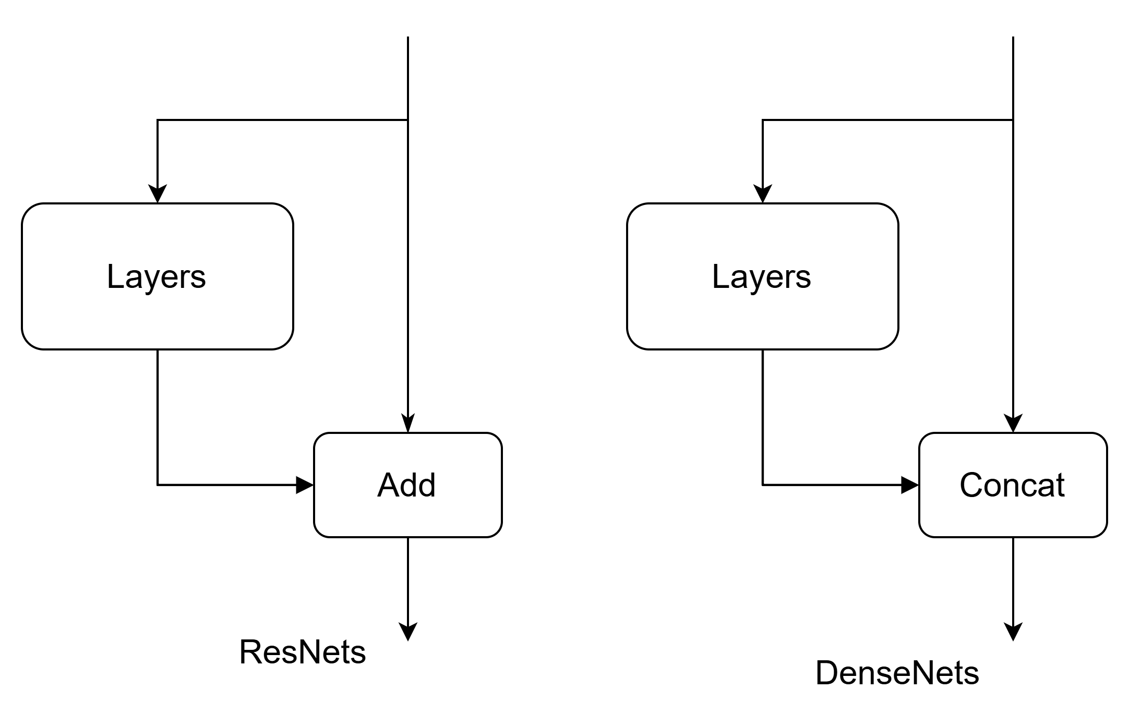
Skip Connections
Notes:
The point of this slide is to show the key innovation behind densenets: output concatenation

Slide 4


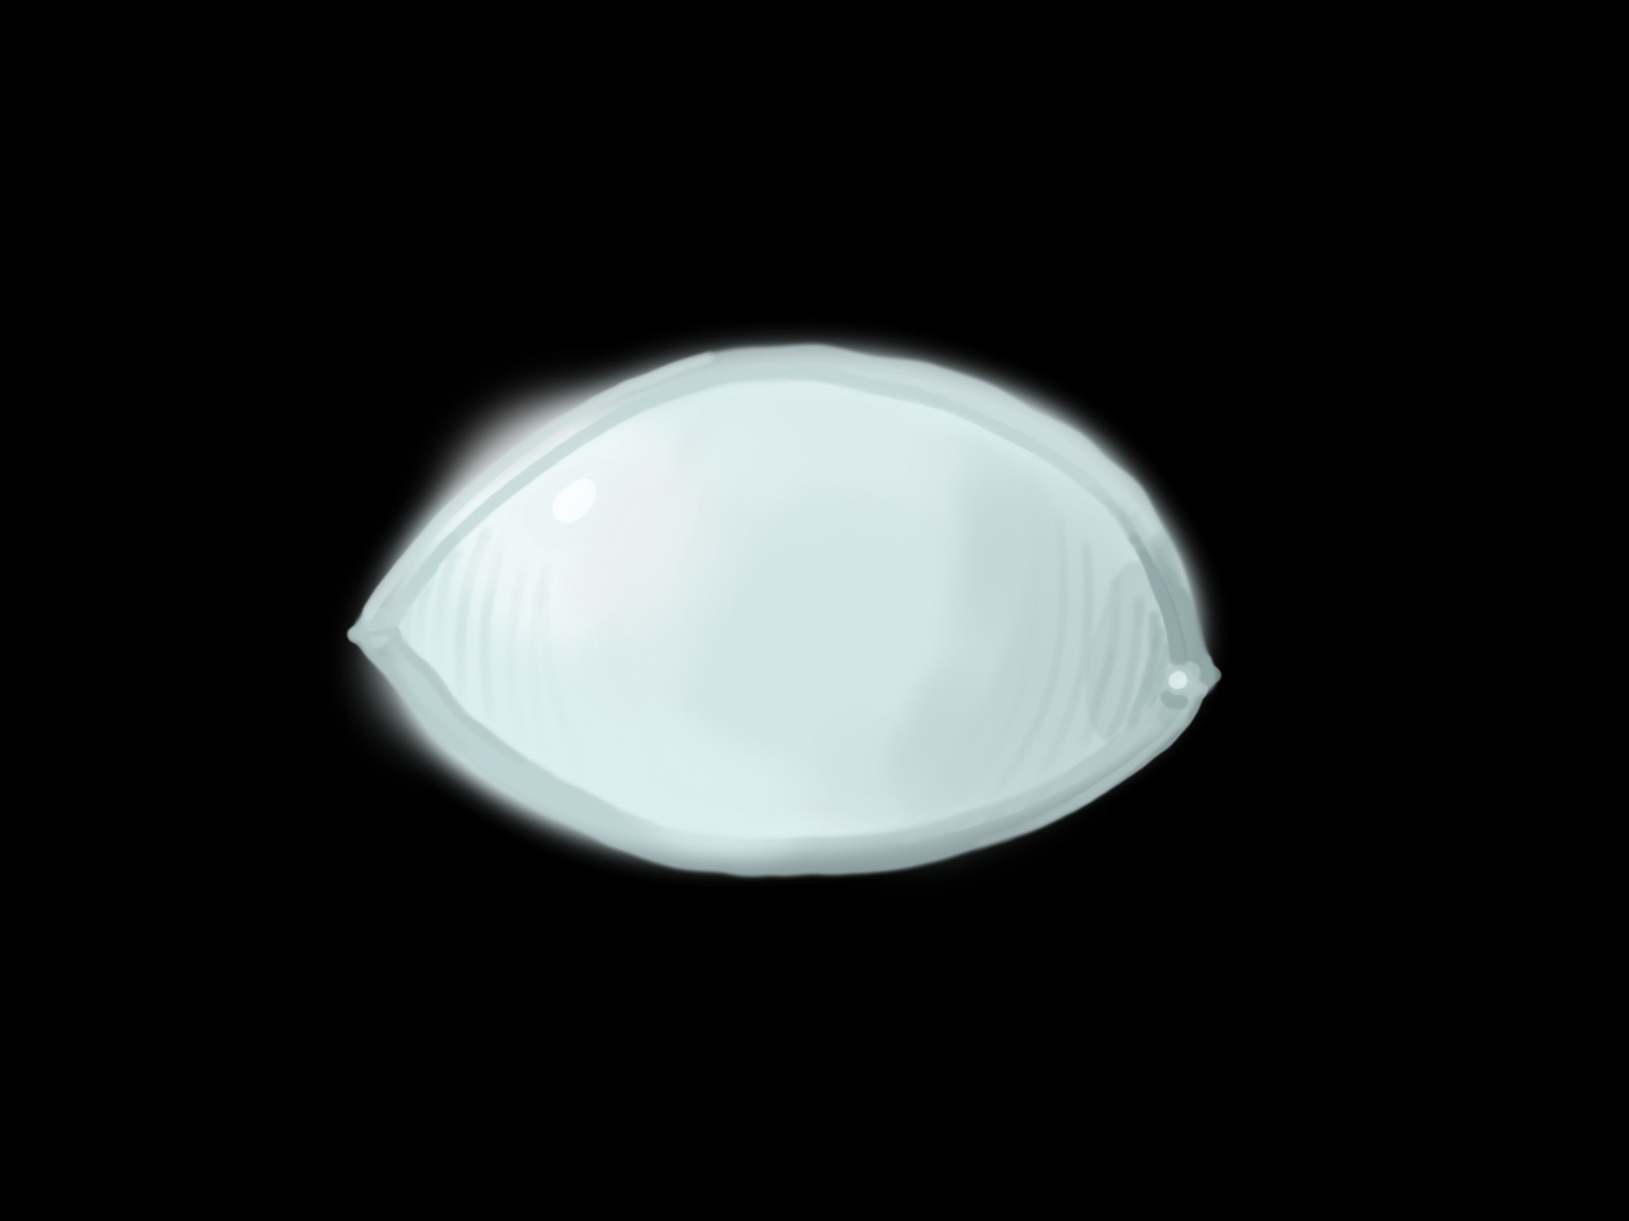


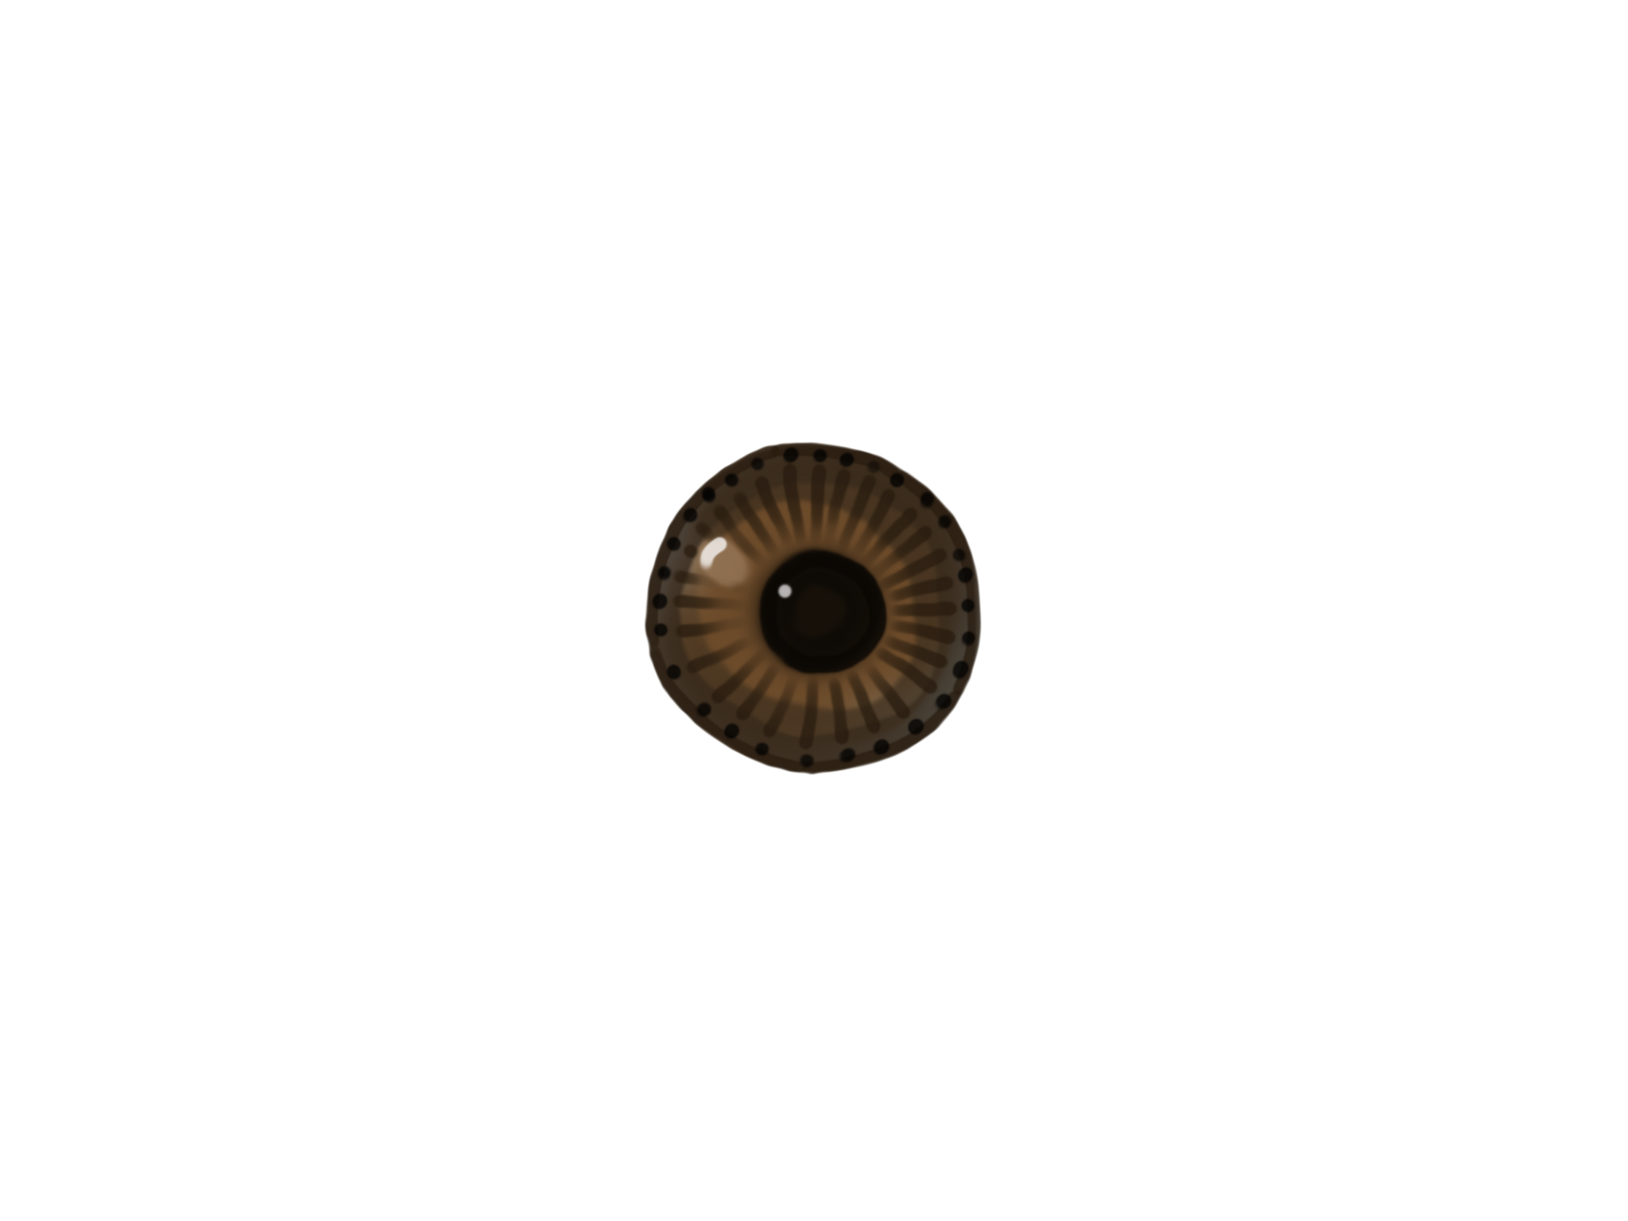
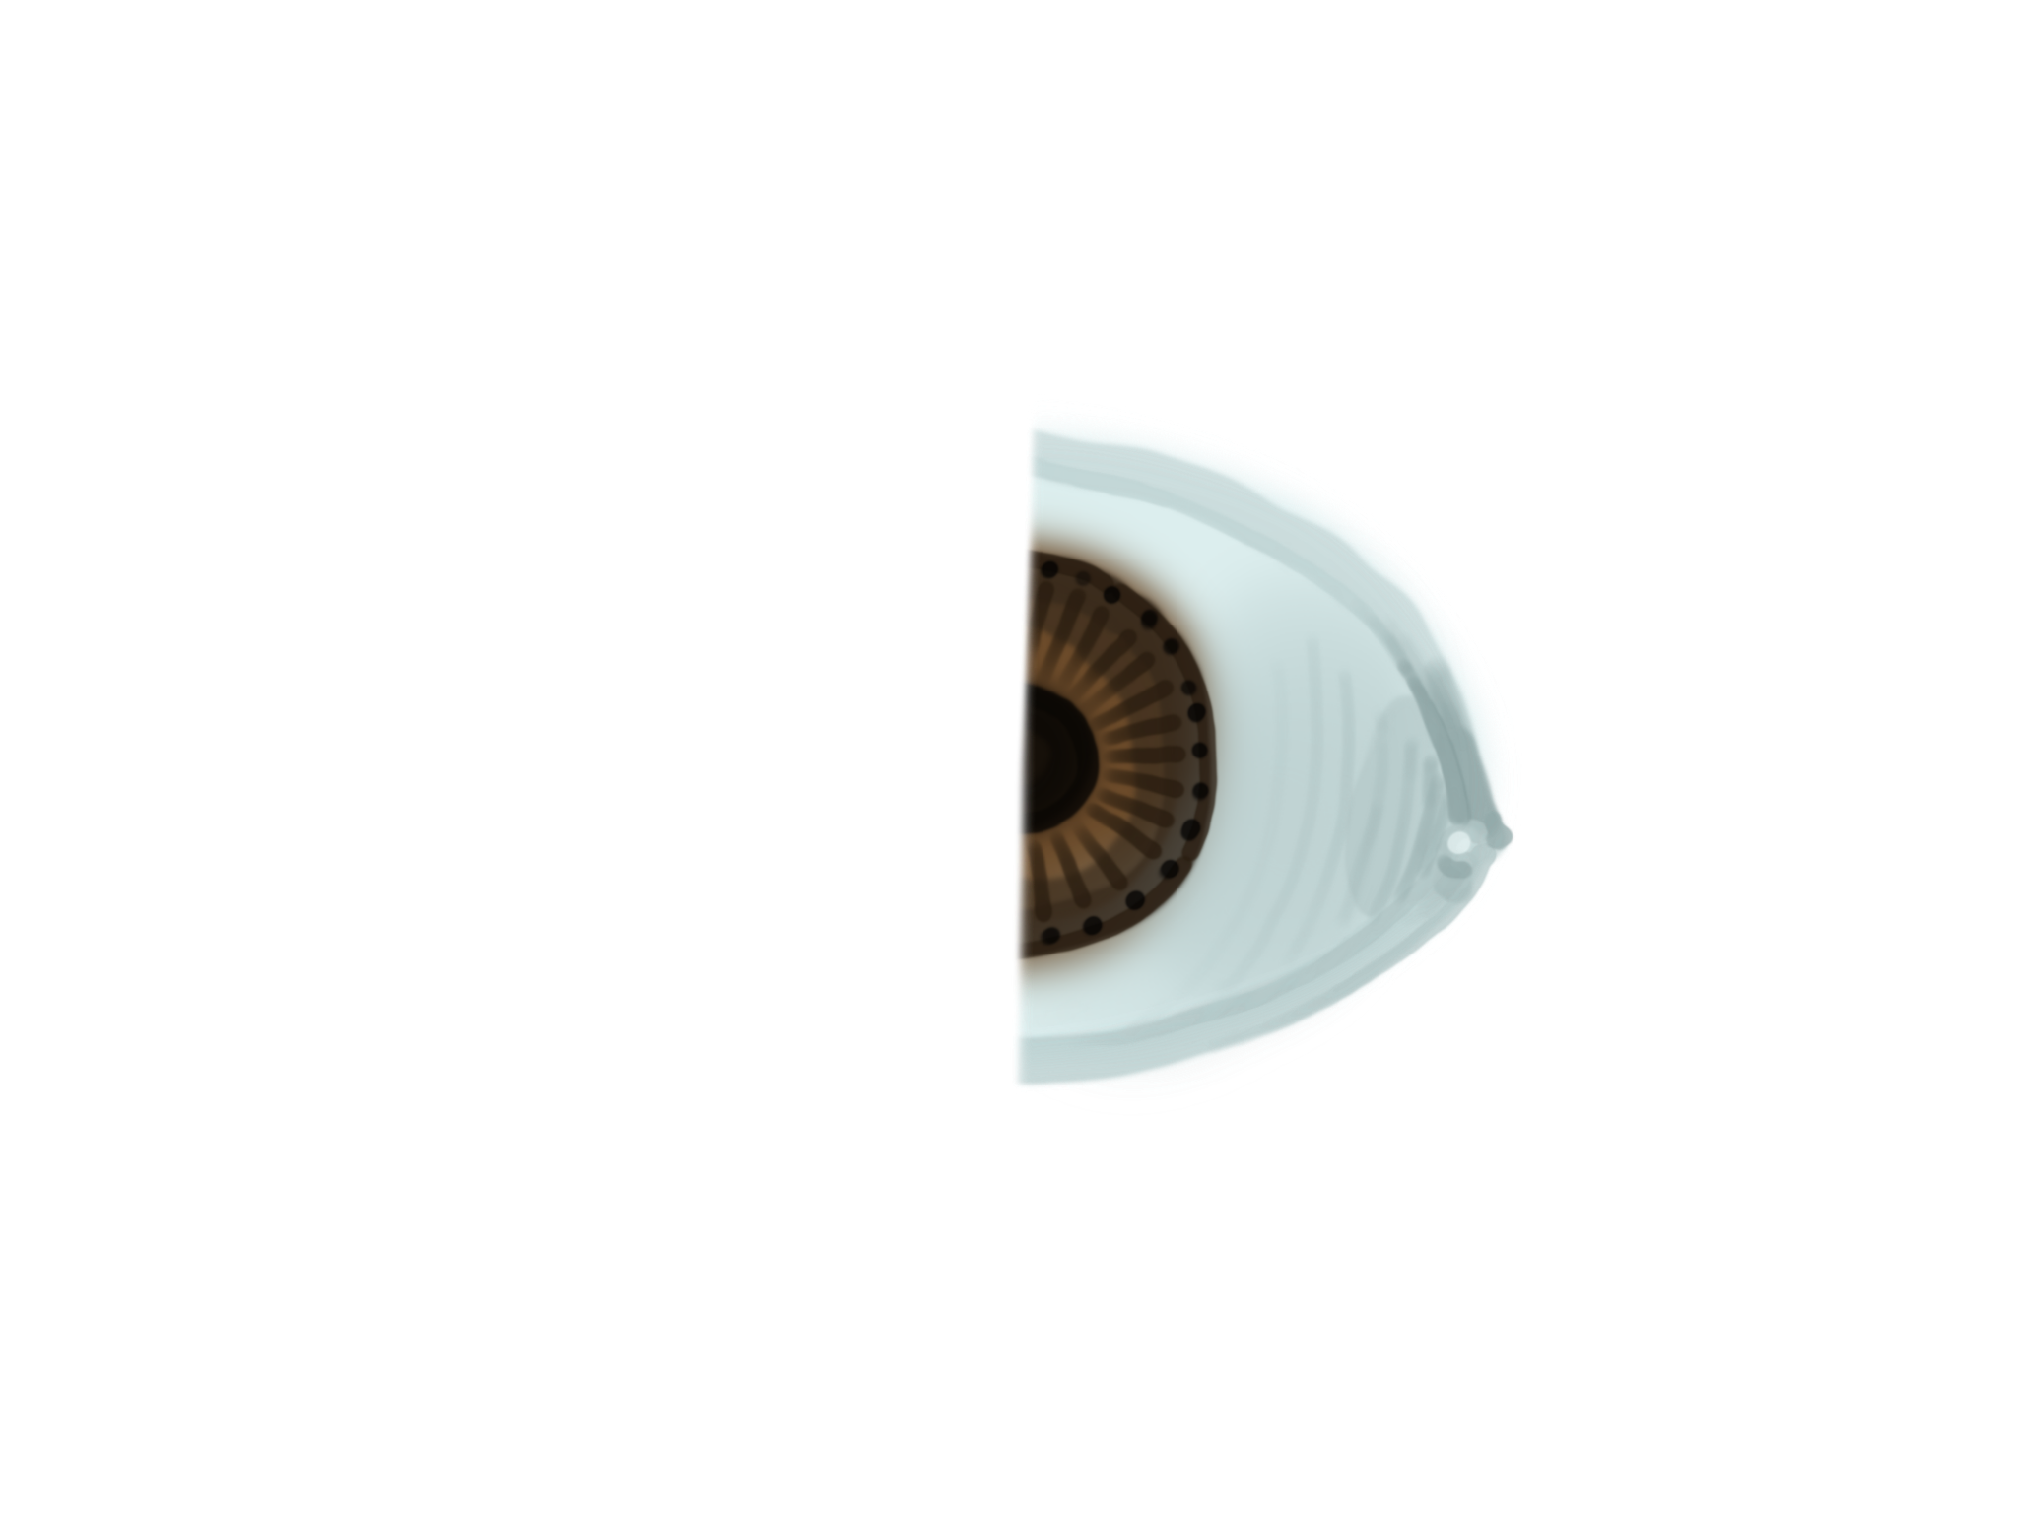


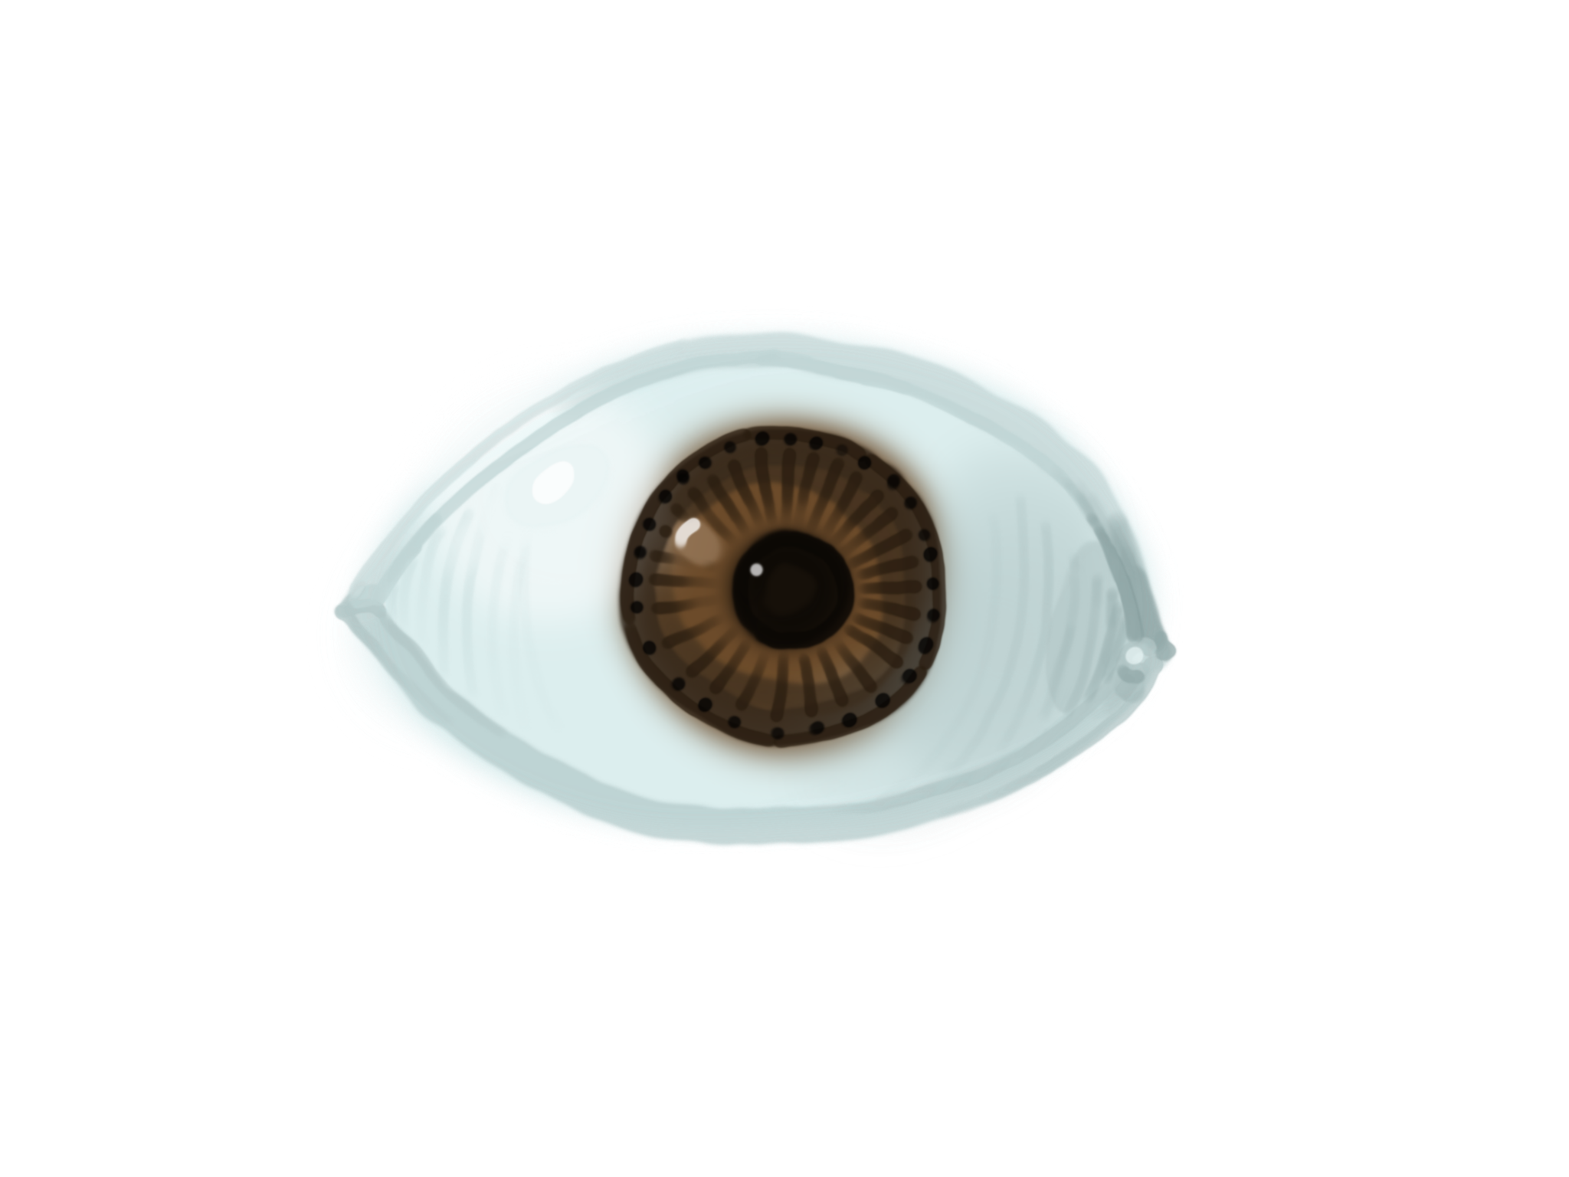
Why Concatenation?
+
+
+
… ?
Notes:
The point of this slide is to illustrate the difference between adding and concatenating, and how concatenating preserves information about learned representations within the model. The authors speculate this is why densenets can learn more diverse feature mappings than resnets or cnns with skip connections. The growth of the intermediate results’ size should also be noted, since this is why densenets aren’t scalable and haven’t seen much use. Could be insightful to use this to illustrate why skip connections solve the vanishing gradient problem (layerwise predictions may get more subtle, but adding (or concatenating) to previous output preserves redundant information, causes later layers to learn ‘finer’ details)

Slide 5
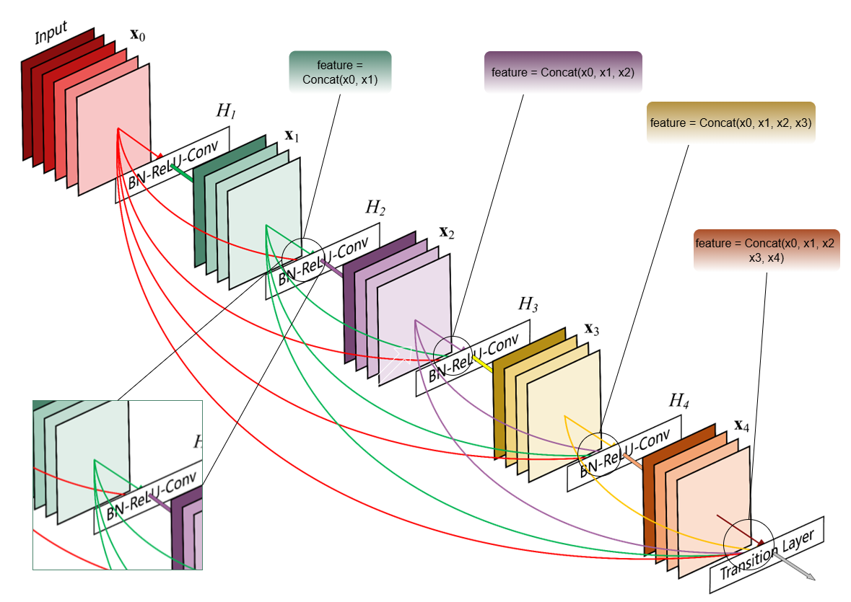
DenseNets Block - Concatenation
Source: Huang, G., Liu, Z., van der Maaten, L., & Weinberger, K. Q. (2016).
Densely connected convolutional networks. arXiv preprint arXiv:1608.06993.
https://arxiv.org/abs/1608.06993
Notes:
The point of this slide is to introduce the main solution to densenets memory scaling issue: the transition layer. This is the main focus of rdnet: adding more transition layers to prevent the intermediate results from getting too large. The reason the authors suspect they can do this without compromising performance is maybe too theoretical to get into (?). This allows them to make rdnet wider and shallower, allowing for faster inference. This slide also illustrates the density of the densenet architecture.

Slide 6
SOTA Models – Residual Learning Lineage
Recent SOTA Backbone Networks | Backend Type
ConvNeXt (CVPR 22) | ResNets
HorNet (NeurIPS) | ResNets
VAN (CVMJ 23) | Vision Transformers
BiFormer (CVPR 23) | Vision Transformers
NAT (CVPR 23) | Vision Transformers
SMT (ICCV 23) | Vision Transformers
MogaNet (ICLR 24) | ResNets
Model | Top-1 (%) | Params (M) | Flops (G) | Memory (32b, G)
ResNet-101 (ILSVRC 2015) | 77.4 | 44.5 | 7.8 | 6.0
DenseNet-161 (CVPR 2016) | 77.1 | 28.7 | 7.7 | 9.7
ConvNext-T (CVPR 2022) | 82.1 | 28.6 | 4.5 | 5.0
Notes:
The point of this slide is to show that densenets are not used as the backbone for sota models at the time of the paper and to show the reason for that: the memory cost. This slide also introduces a contemporary model that rdnet takes architectural inspiration from and will be further compared against: convnext (I believe a different team is covering convnext, might be worth mentioning). (I have a few questions about this slide, particularly that it doesn’t seem like densenets are leading in any capacity, at least according to the chart. Couldn’t someone say that’s the reason why nobody is using densenets. I think the solution would be to add the year released to the chart: ResNet-101: 2015, DenseNet-161: 2016, ConvNext-T: 2022. I believe the main advantage of DenseNet at the time was a significant reduction in parameters)

Slide 7
Motivation
Claim: DenseNets can outperform residual networks with Additive Skip Connections
DenseNets aren’t scalable
DenseNets consume very large amounts of memory
Additive shortcuts and Restricted Architectural Diversity and Innovation
To showcase the potential of the DenseNet style architecture
Notes:
The point of this slide is to motivate rdnet. The memory scaling problem and disadvantage of additive shortcuts were illustrated in the previous slide.

Slide 8
Methodology
Better Training Recipe
A strategic design that mitigates memory consumption issues
Use of intermediate dimension reducers (Transition Layers)
Going wider and shallower
Modern Block Design (ConvNext)
Notes:
The point of this slide is to wrap up the additions of rdnet. Most of these would have been mentioned up to this point. This should be a 2 second slide.

Slide 9
Better Training Recipe
Linear Warmup
AdamW and Cosine Learning Rate
Label Smoothing
Large Epochs Training Setup
Stochastic Depth
Random Augment and Erasing
Mixup and Cutmix
Notes:
The point of this slide is to expand on the better training recipe mentioned in the previous slide. I wouldn’t go into these in too much depth.
Densenets havent been given the care the residual networks have been given.

Slide 10
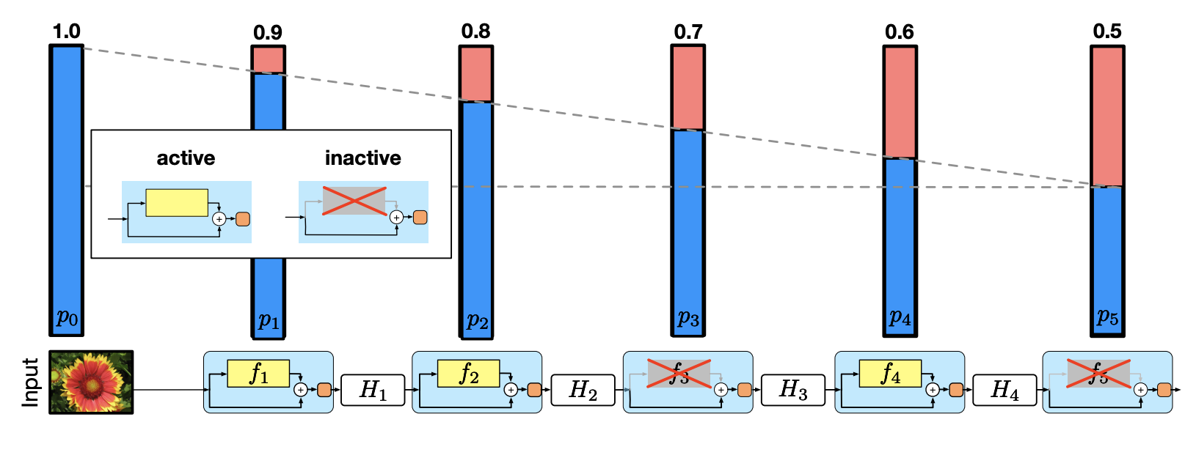
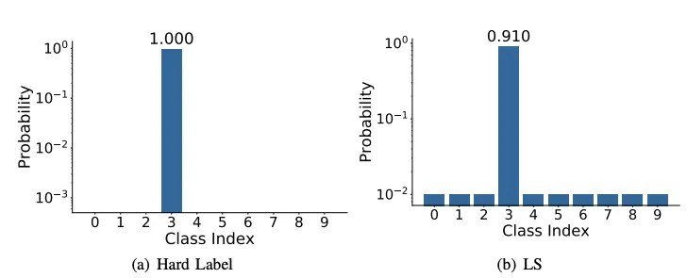
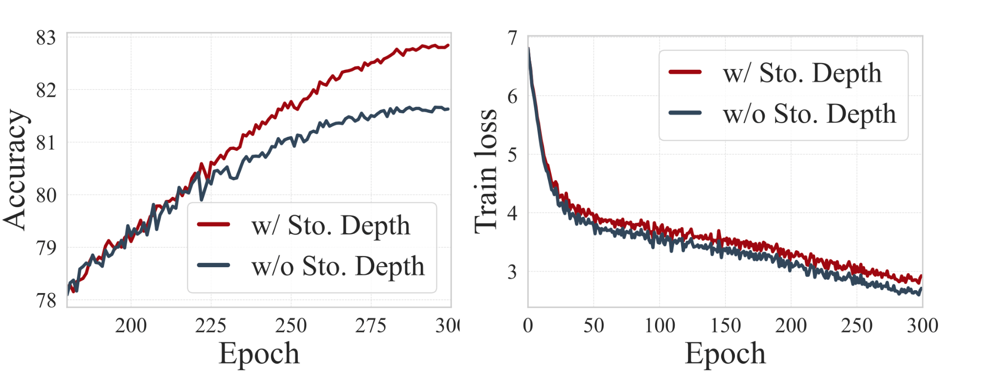
Stochastic Depth and Label Smoothing
Aims to shrink the depth of a network
Linear Decay as you go deeper
Makes the network less confident
Used to increase robustness
Source: Kim, Donghyun, et al. DenseNets Reloaded: Paradigm Shift Beyond ResNets and ViTs. arXiv, 2024. DOI.org (Datacite), https://doi.org/10.48550/ARXIV.2403.19588.
Notes:
The idea is give to give a brief about of Label Smoothing and Stochastic Depth. Both of which help regularize the model. Stochastic Depth is like dropout but for layers or whole residual blocks instead of neurons.
Aims to shrink the depth of a network during training, while keeping it unchanged during testing.
Label Smoothing makes the network less confident then it actually is on the classes.
Label smoothing is often used to increase robustness and improve classification problems

Slide 11
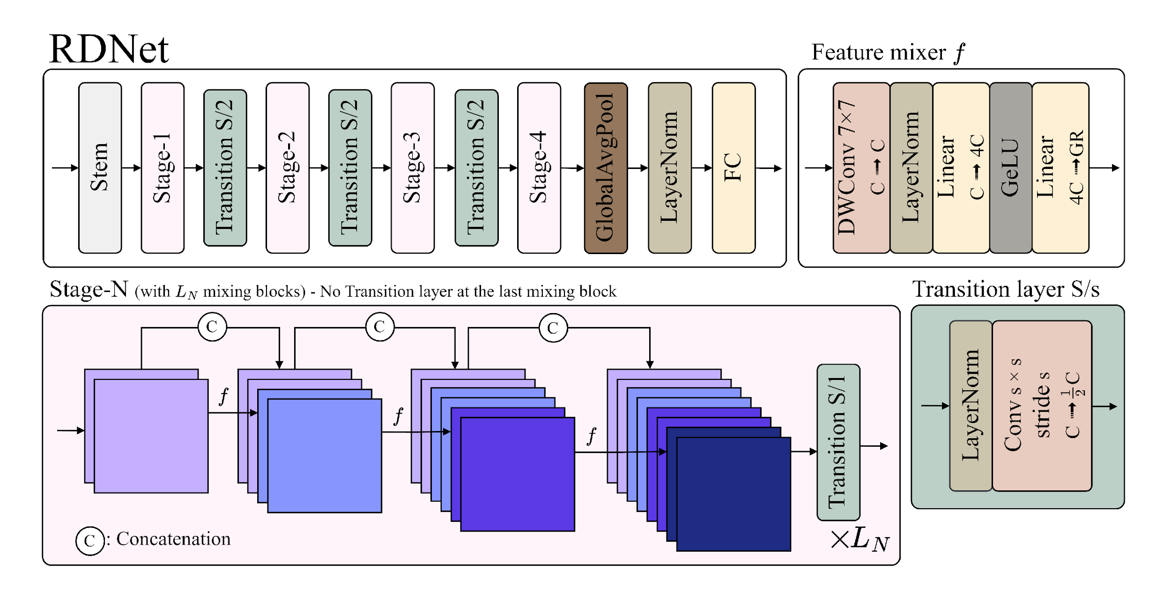
Revitalized DenseNet - RDNet
Stages
Feature Mixer
Transition Layers
Source: Kim, Donghyun, et al. DenseNets Reloaded: Paradigm Shift Beyond ResNets and ViTs. arXiv, 2024. DOI.org (Datacite), https://doi.org/10.48550/ARXIV.2403.19588.
Notes:
Introducing RDNet (Revitalized Dense Nets), authors approach given the various things we’ve discussed in previous slides
RDNet features a unique design distinguishing it from ResNet-style architectures, primarily due to the use of feature concatenation.

Slide 12
Stage-N
Transition Layer after every 3 intervals
Feature Mixer
xL_{N} Mixing Block per stage
Each stage has an associated Growth Rate
Source: Kim, Donghyun, et al. DenseNets Reloaded: Paradigm Shift Beyond ResNets and ViTs. arXiv, 2024. DOI.org (Datacite), https://doi.org/10.48550/ARXIV.2403.19588.
Notes:
We design four stages in RDNet across all scales, where each stage N comprises, LN mixing blocks consisting of three feature mixers and one transition layer (the last mixing block does not employ the transition layer).
Feature mixer f denotes our building block combines previously concatenated features to compress them into GR-dimensional features for concatenation.
The growth rate (GR) adjusts the amount of concatenated features and is predetermined for each stage. Transition layers for down sampling are positioned after each stage as before. S and C denote stride and channel size. This figure illustratively sets GR to two.

Slide 13
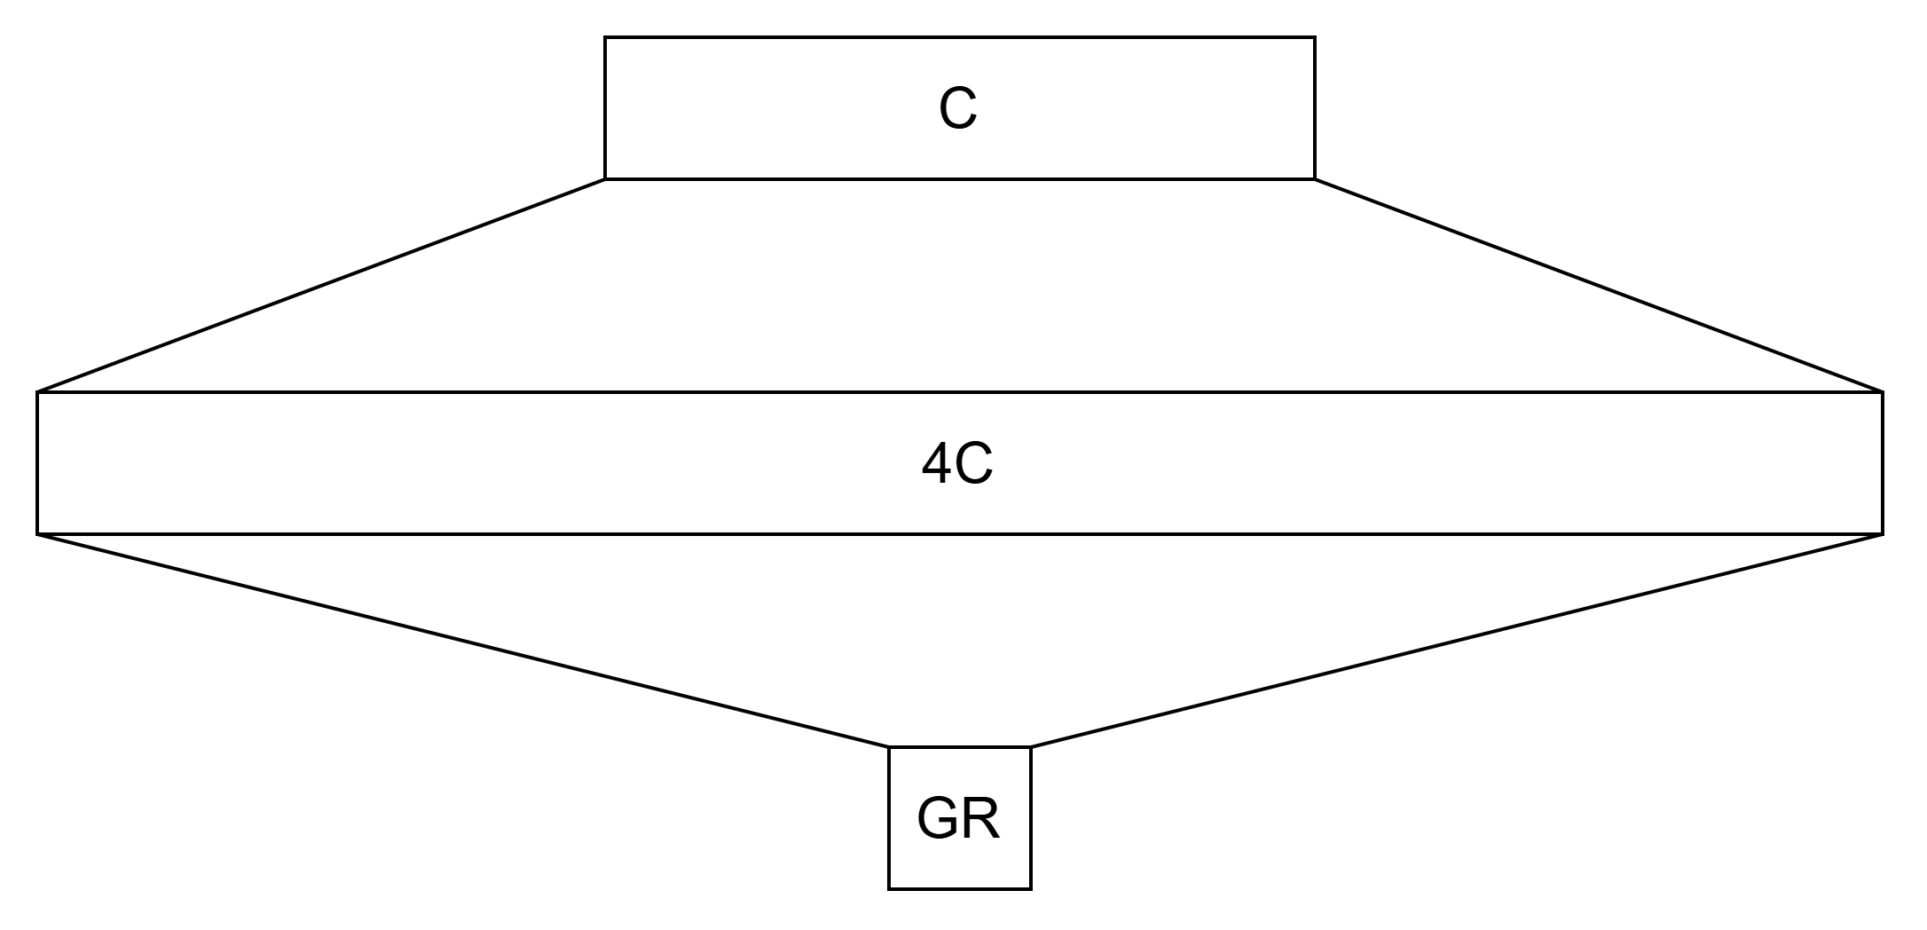
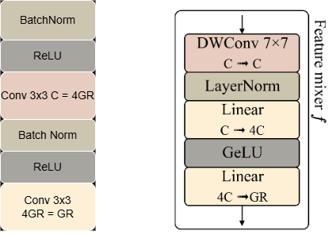
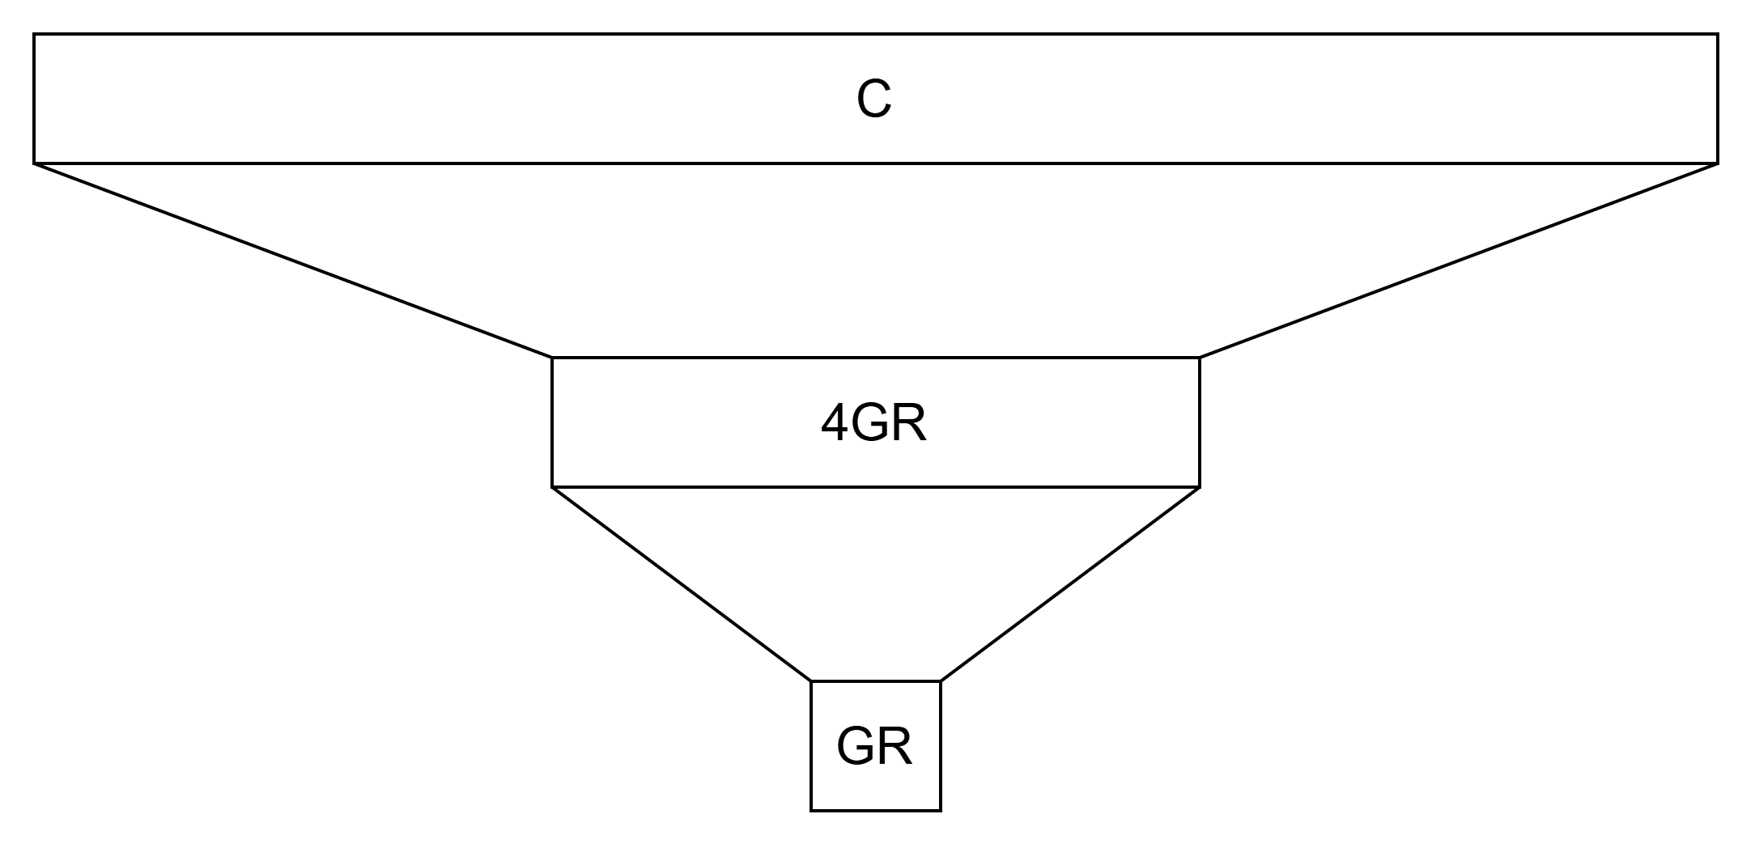
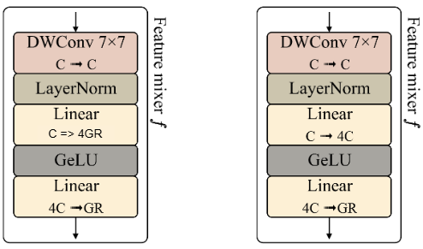
Modernized Feature Mixer
Larger Intermediate Channel Dimension
Decoupling the ER from GR
ER proportional to input dimension
Inverted Bottleneck Connection
DenseNet Feature Mixer
Bottleneck Connection
Initial Feature Mixer
Block
Modernized Feature Mixer Block
Source: Kim, Donghyun, et al. DenseNets Reloaded: Paradigm Shift Beyond ResNets and ViTs. arXiv, 2024. DOI.org (Datacite), https://doi.org/10.48550/ARXIV.2403.19588.
Notes:
Emphasizing the wider and shallower design, the expansion ratio ER (controlling the channel expansion for inverted bottleneck layer similar to DenseNet-201 where ER=4×GR but in RDNet ER has been decoupled from GR)
This causes Larger intermediate channel dimensions. DenseNets similarly employed the ER concept; however, they distinctively applied it to the growth rate (GR) (e.g., ER=4×GR for original densenet) rather than to the input dimension to reduce both input and output dimensions.
They argue that this harms the capability of encoded features through the nonlinearity [26]. Thus, they reengineer the approach by directing ER proportional to the input dimension (i.e., decoupling ER from GR).
To mitigate any extra memory consumption they reduce the GR from 120 to 60 without compromising accuracy.

Slide 14
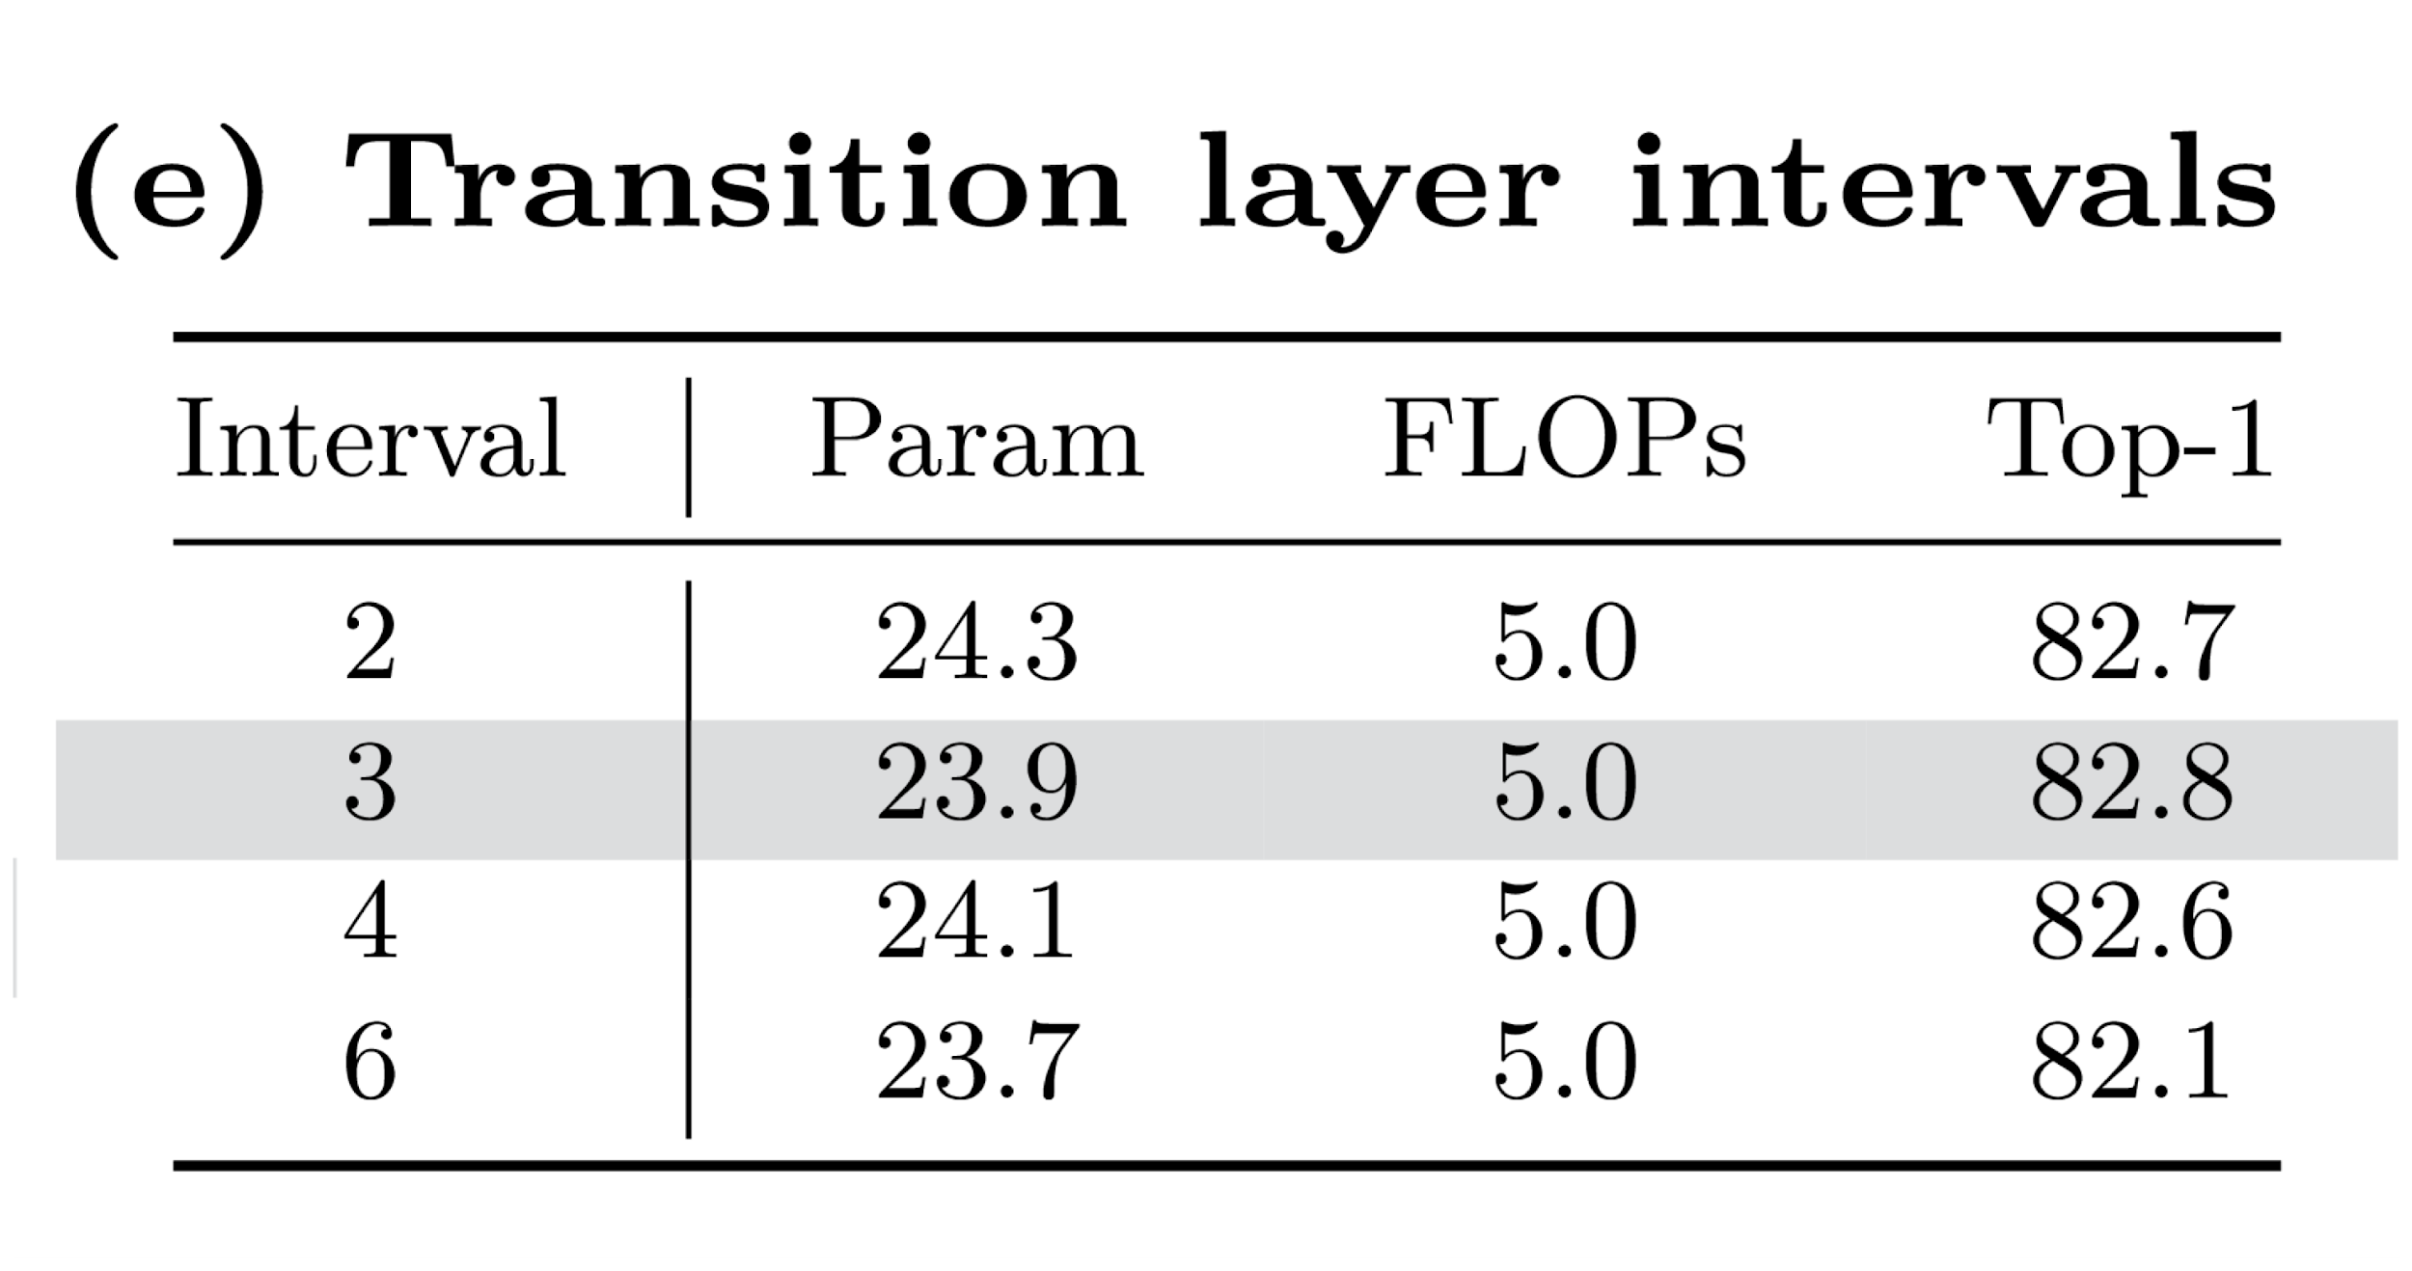
Transition Layers
Works as intermediate dimension reducer
Mitigates Memory Concerns
Dimension Reduction within Stages
Downsampling between stages
Source: Kim, Donghyun, et al. DenseNets Reloaded: Paradigm Shift Beyond ResNets and ViTs. arXiv, 2024. DOI.org (Datacite), https://doi.org/10.48550/ARXIV.2403.19588.
Notes:
They refine the transition layers, removing the average pooling and replacing the convolution by adjusting the kernel size and stride with the stride Therefore, our transition layers play two additional roles: 1) dimension reduction, as aforementioned; 2) downsampling.
Sxs with stride s

Slide 15
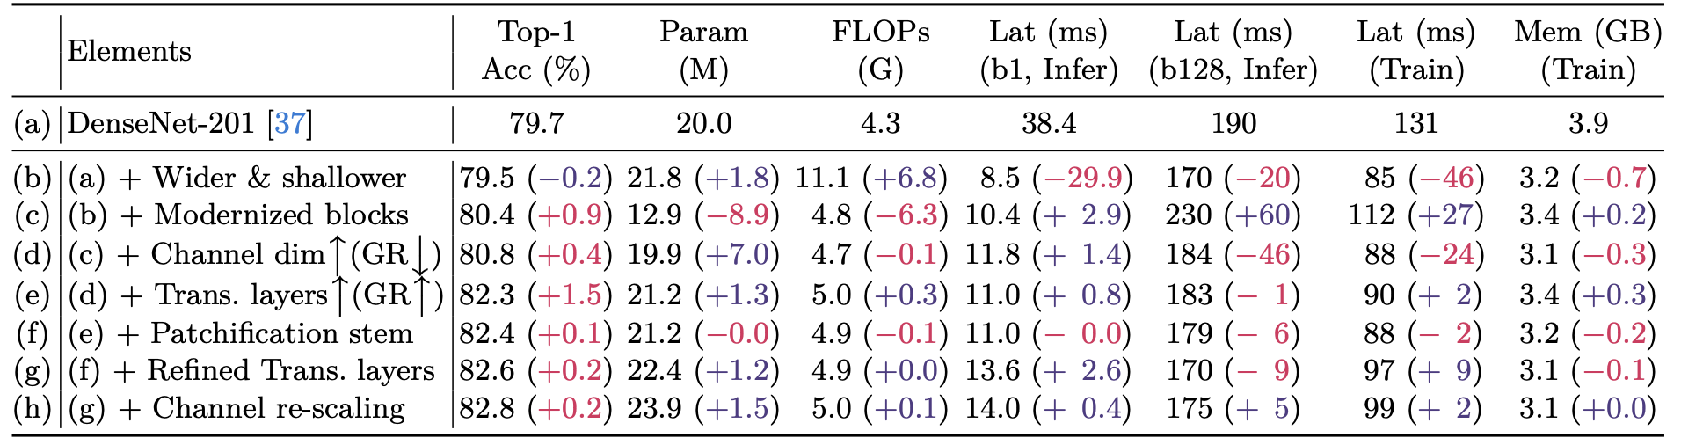
DenseNet to RDNet
Transitioning from DenseNet to Revitalized DenseNet (RDNet)
The authors implemented a series of improvements to modernize the DenseNet architecture.
The improvements aimed at widening DenseNet while also improving performance.
Source: Kim, Donghyun, et al. DenseNets Reloaded: Paradigm Shift Beyond ResNets and ViTs. arXiv, 2024. DOI.org (Datacite), https://doi.org/10.48550/ARXIV.2403.19588.
Notes:
Here I focus on three most important features of RDNet that define its architecture.
For more transition layer the Increase in GR aims to address the overall low GR in the baseline at an architecture level, whereas the abovementioned GR decrease was to boost ER on a block level.
We investigate if channel re-scaling is required due to the
diverse variance of concatenated features. We examine our proposed re-scaling
approach,whichhasasimilarformulationbymergingthechannellayer-scale[76]
and an effective squeeze-excitation network [48]. Table 1(h) indicates it achieves
a slight +0.2%p improvement, albeit with very minor inefficiency

Slide 16

Revitalizing DenseNet
Patchification stem
Notable acceleration in computational speed, without losing precision.
Refined Transition Layers
Removes average pooling, instead uses “adjusted” convolutional layers.
Replacing Batch Norm with Layer Norm.
Channel Re-scaling
Merging layer-scale and effective squeeze-excitation

Slide 17
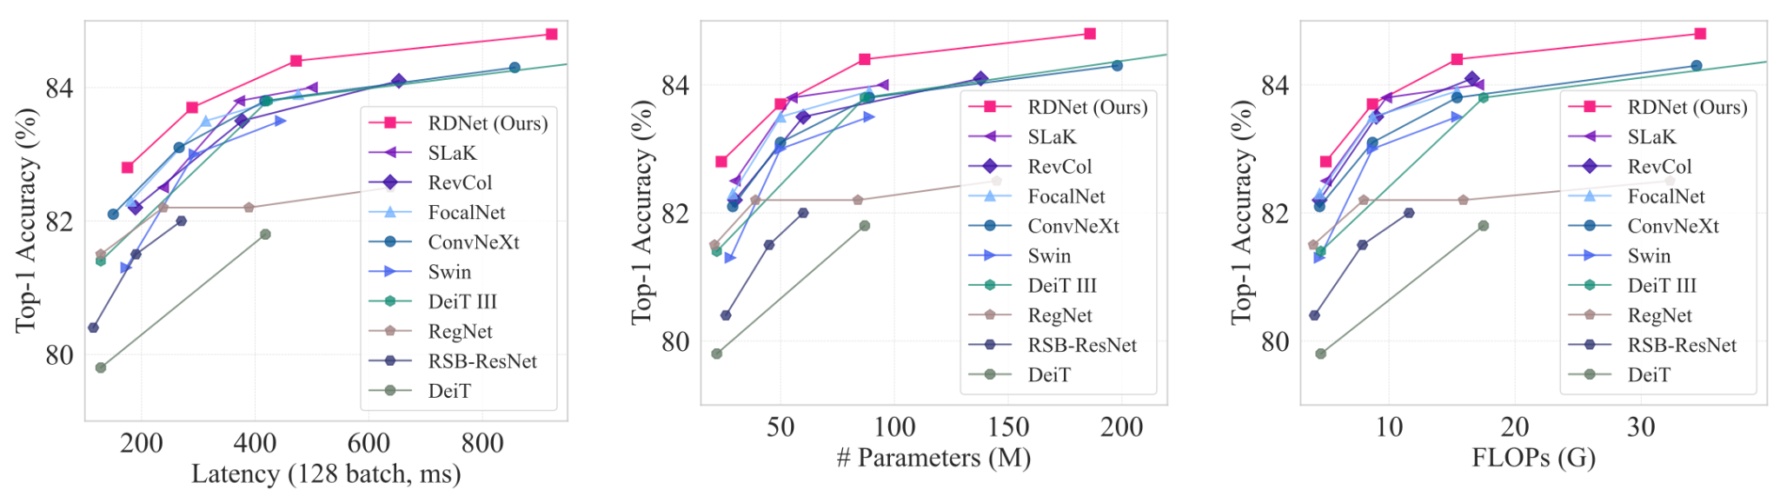
Image Classification Testing
Image Classification (ImageNet-1K)
Compared against Swin Transformer and ConvNeXt
AdamW, 300 epochs, 512 batch size
Identical Data Augmentation and Regularizations

Slide 18
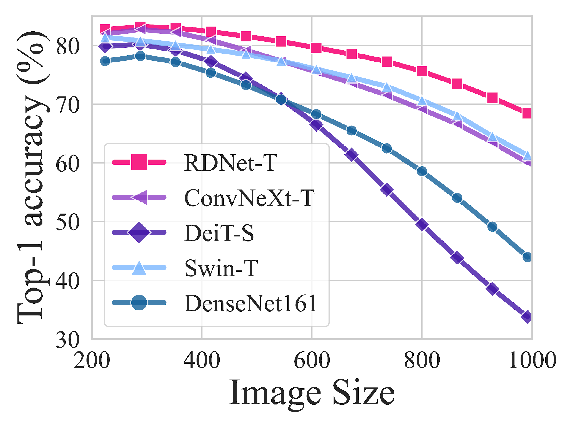
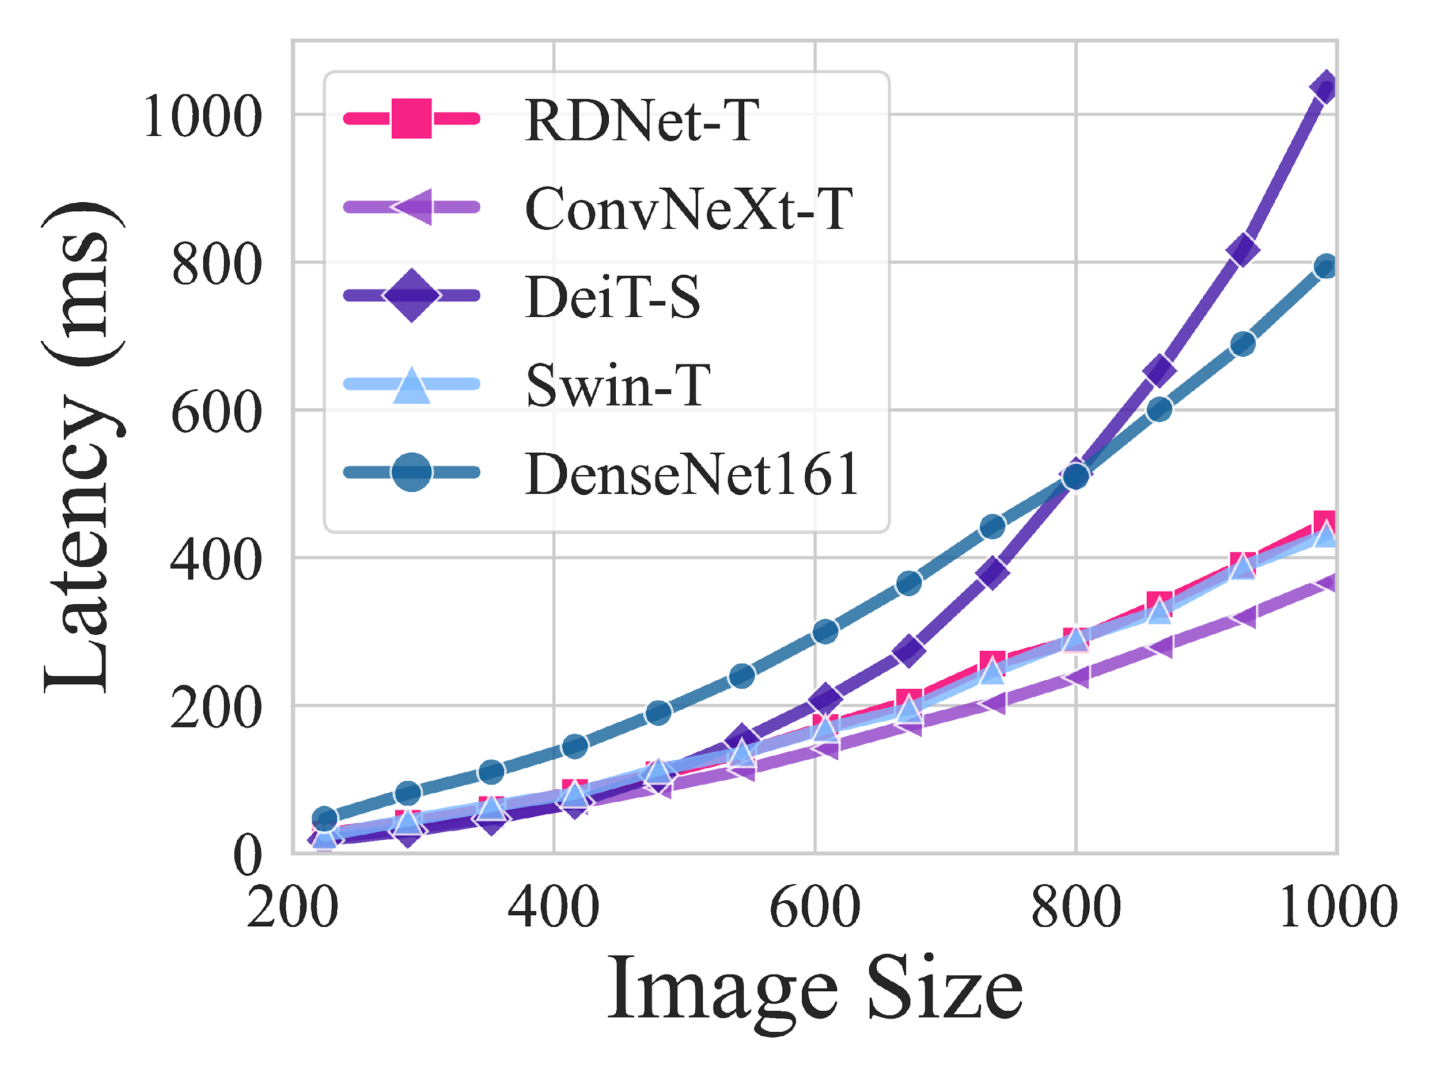
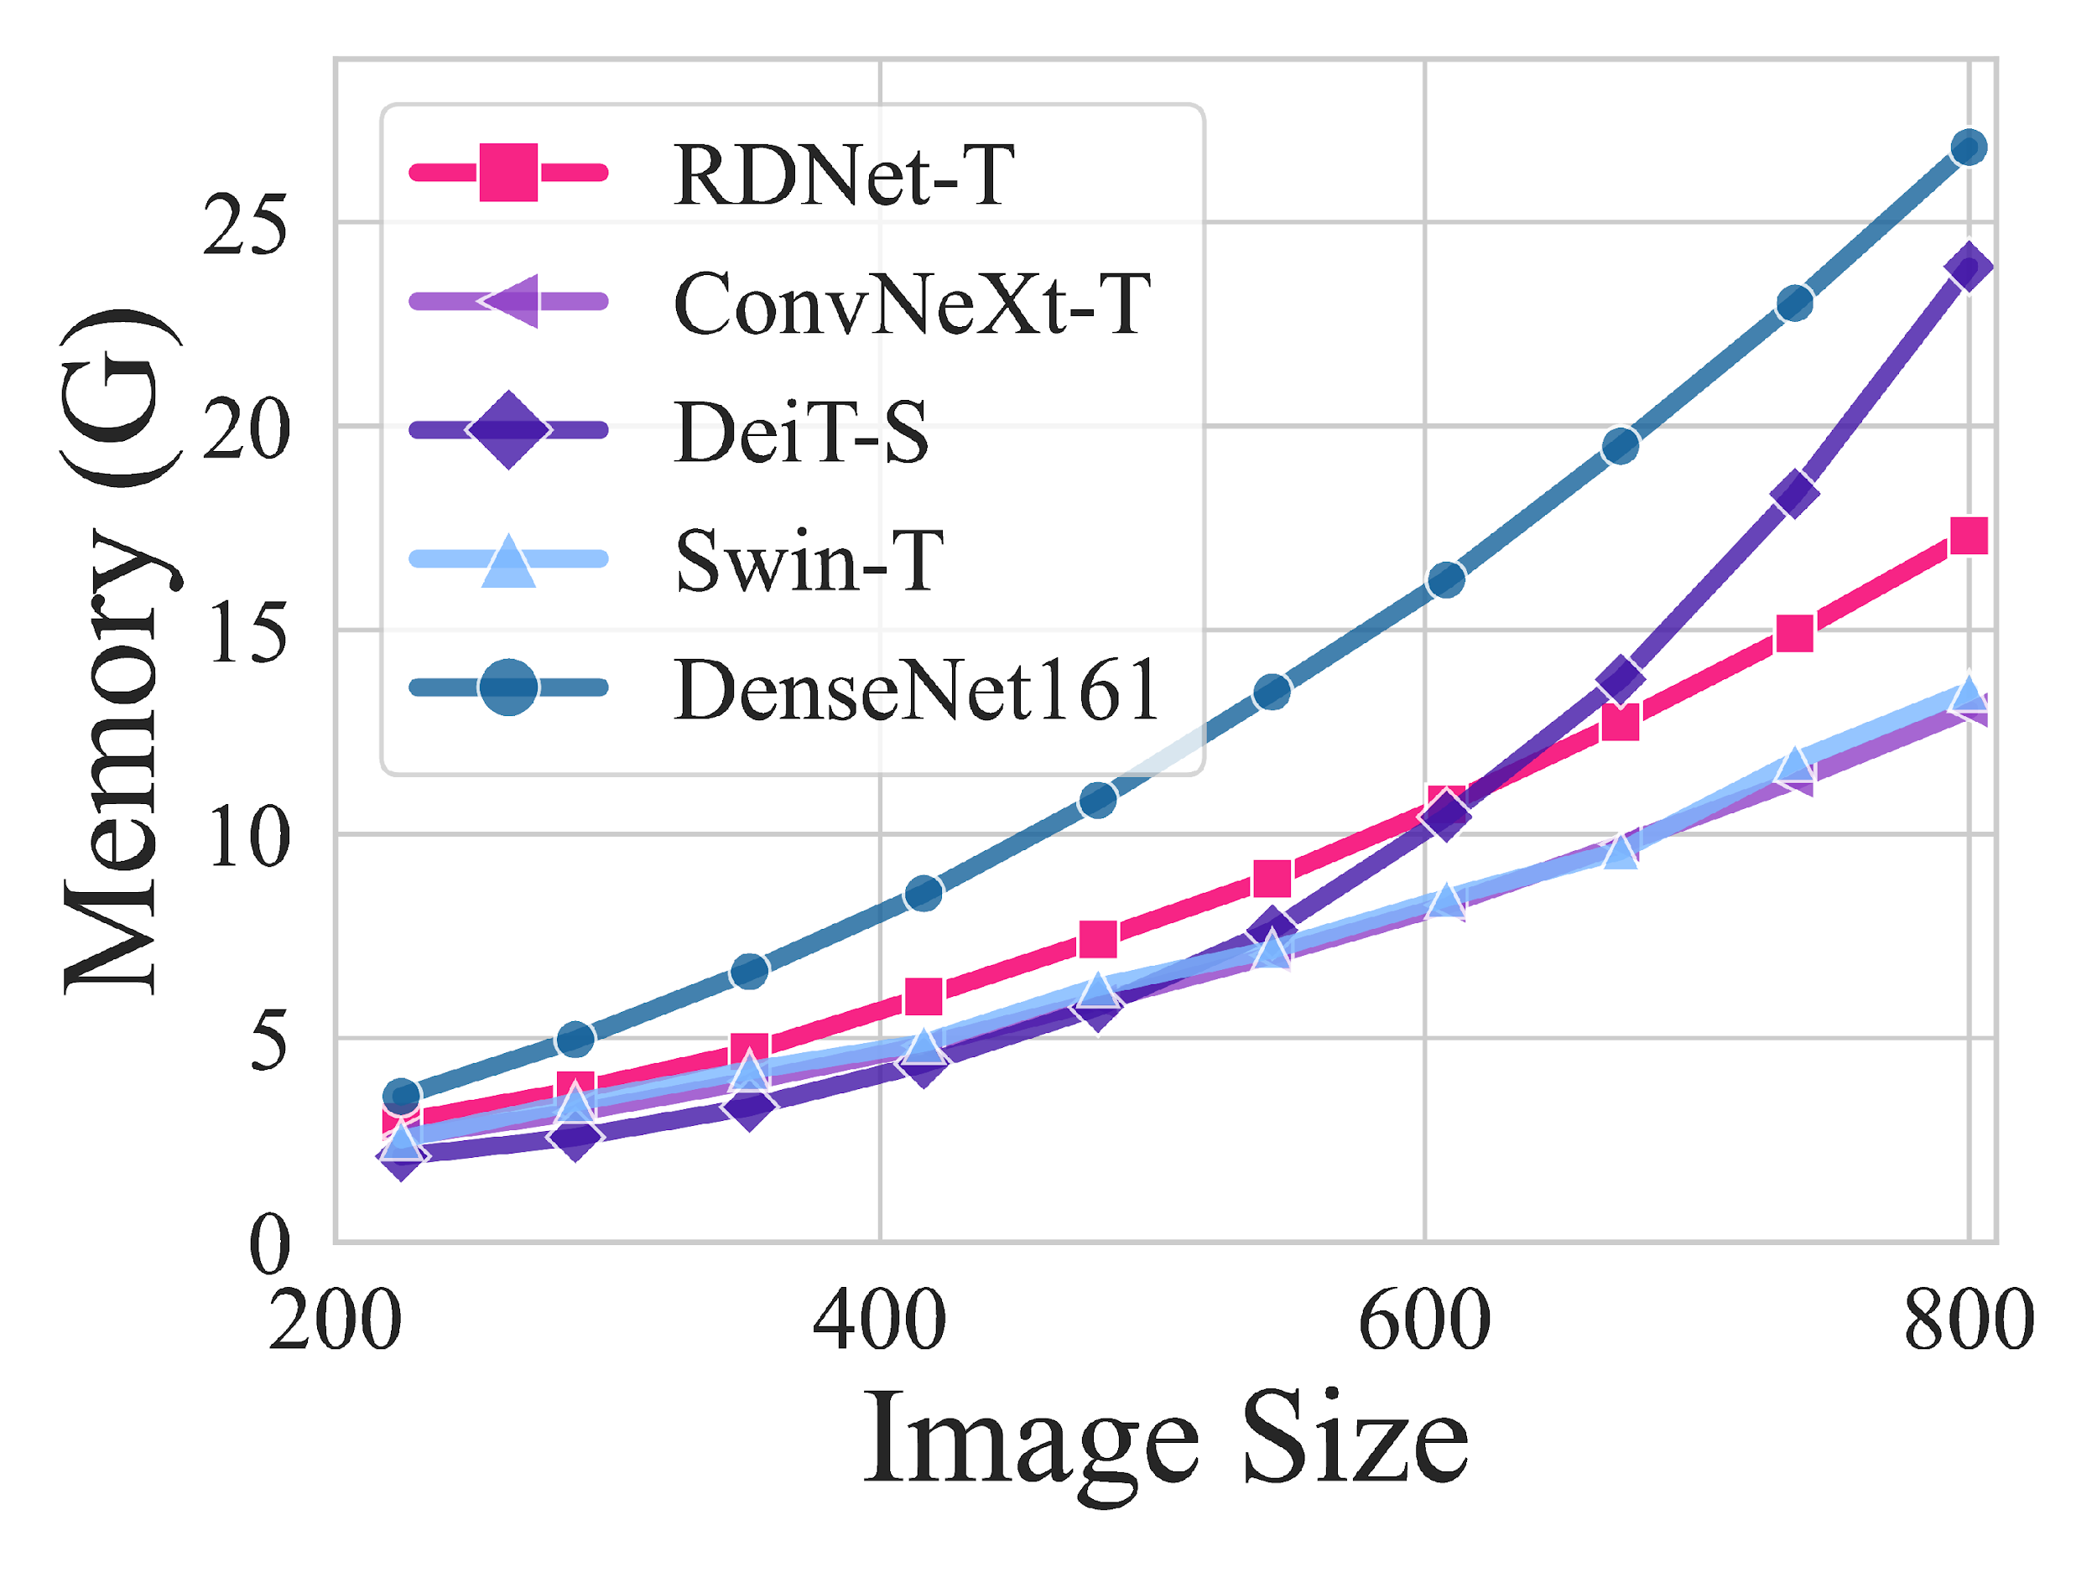
Results ImageNet 1K Comparison
Image Size Implications
RDNet appears robust when image size increases, outperforming competitors in Accuracy, while maintaining competitive latency and memory.
Source: Kim, Donghyun, et al. DenseNets Reloaded: Paradigm Shift Beyond ResNets and ViTs. arXiv, 2024. DOI.org (Datacite), https://doi.org/10.48550/ARXIV.2403.19588.

Slide 19
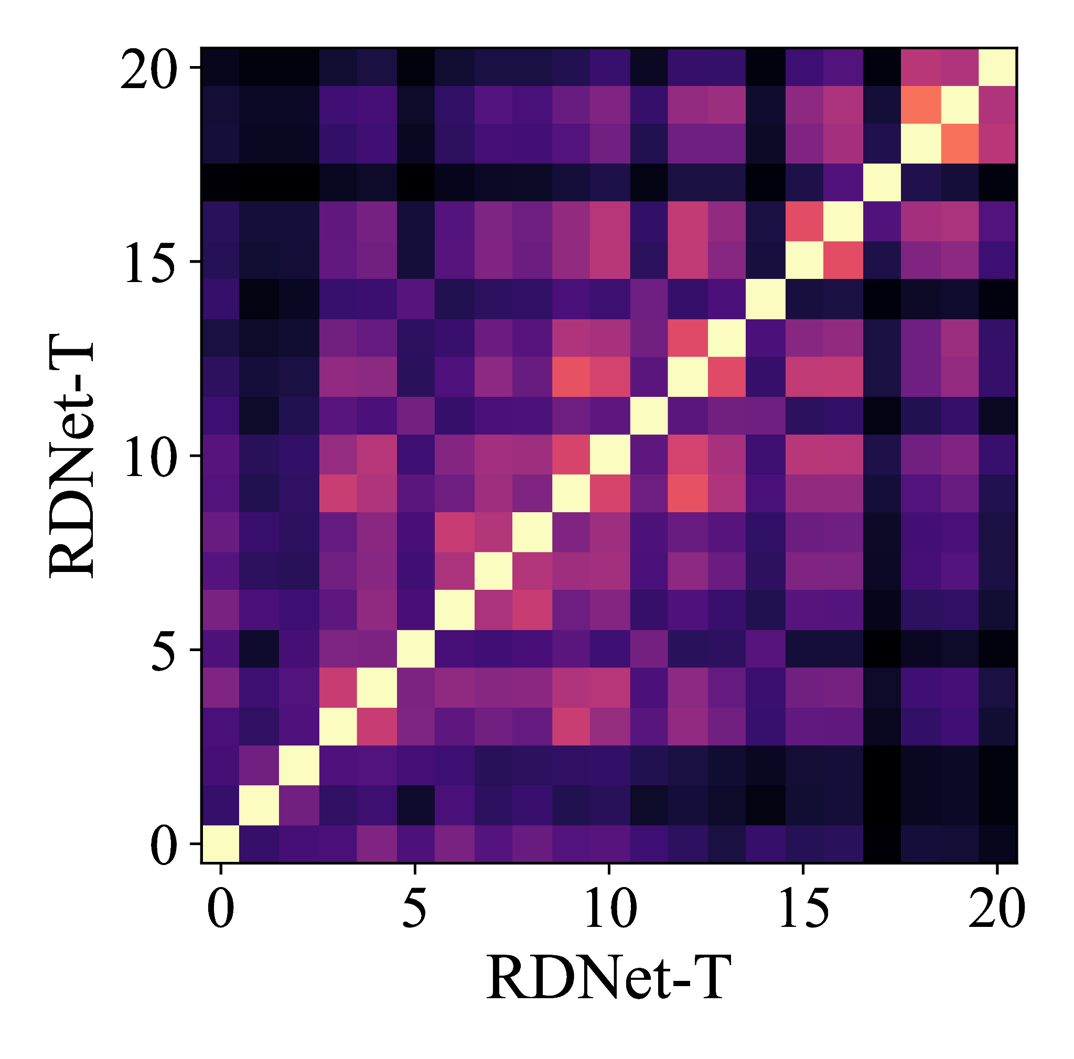
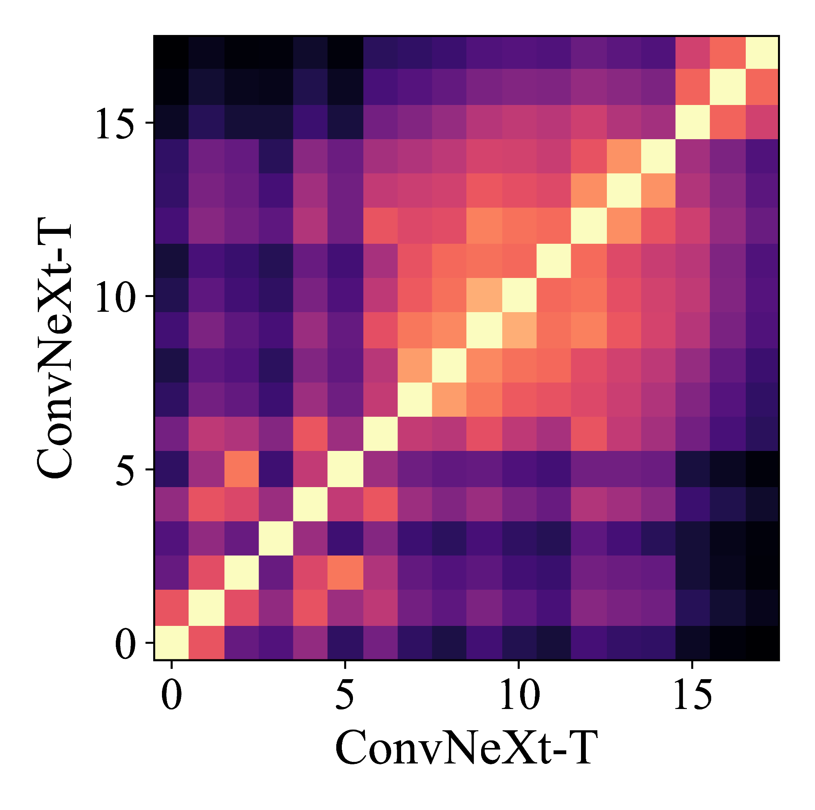
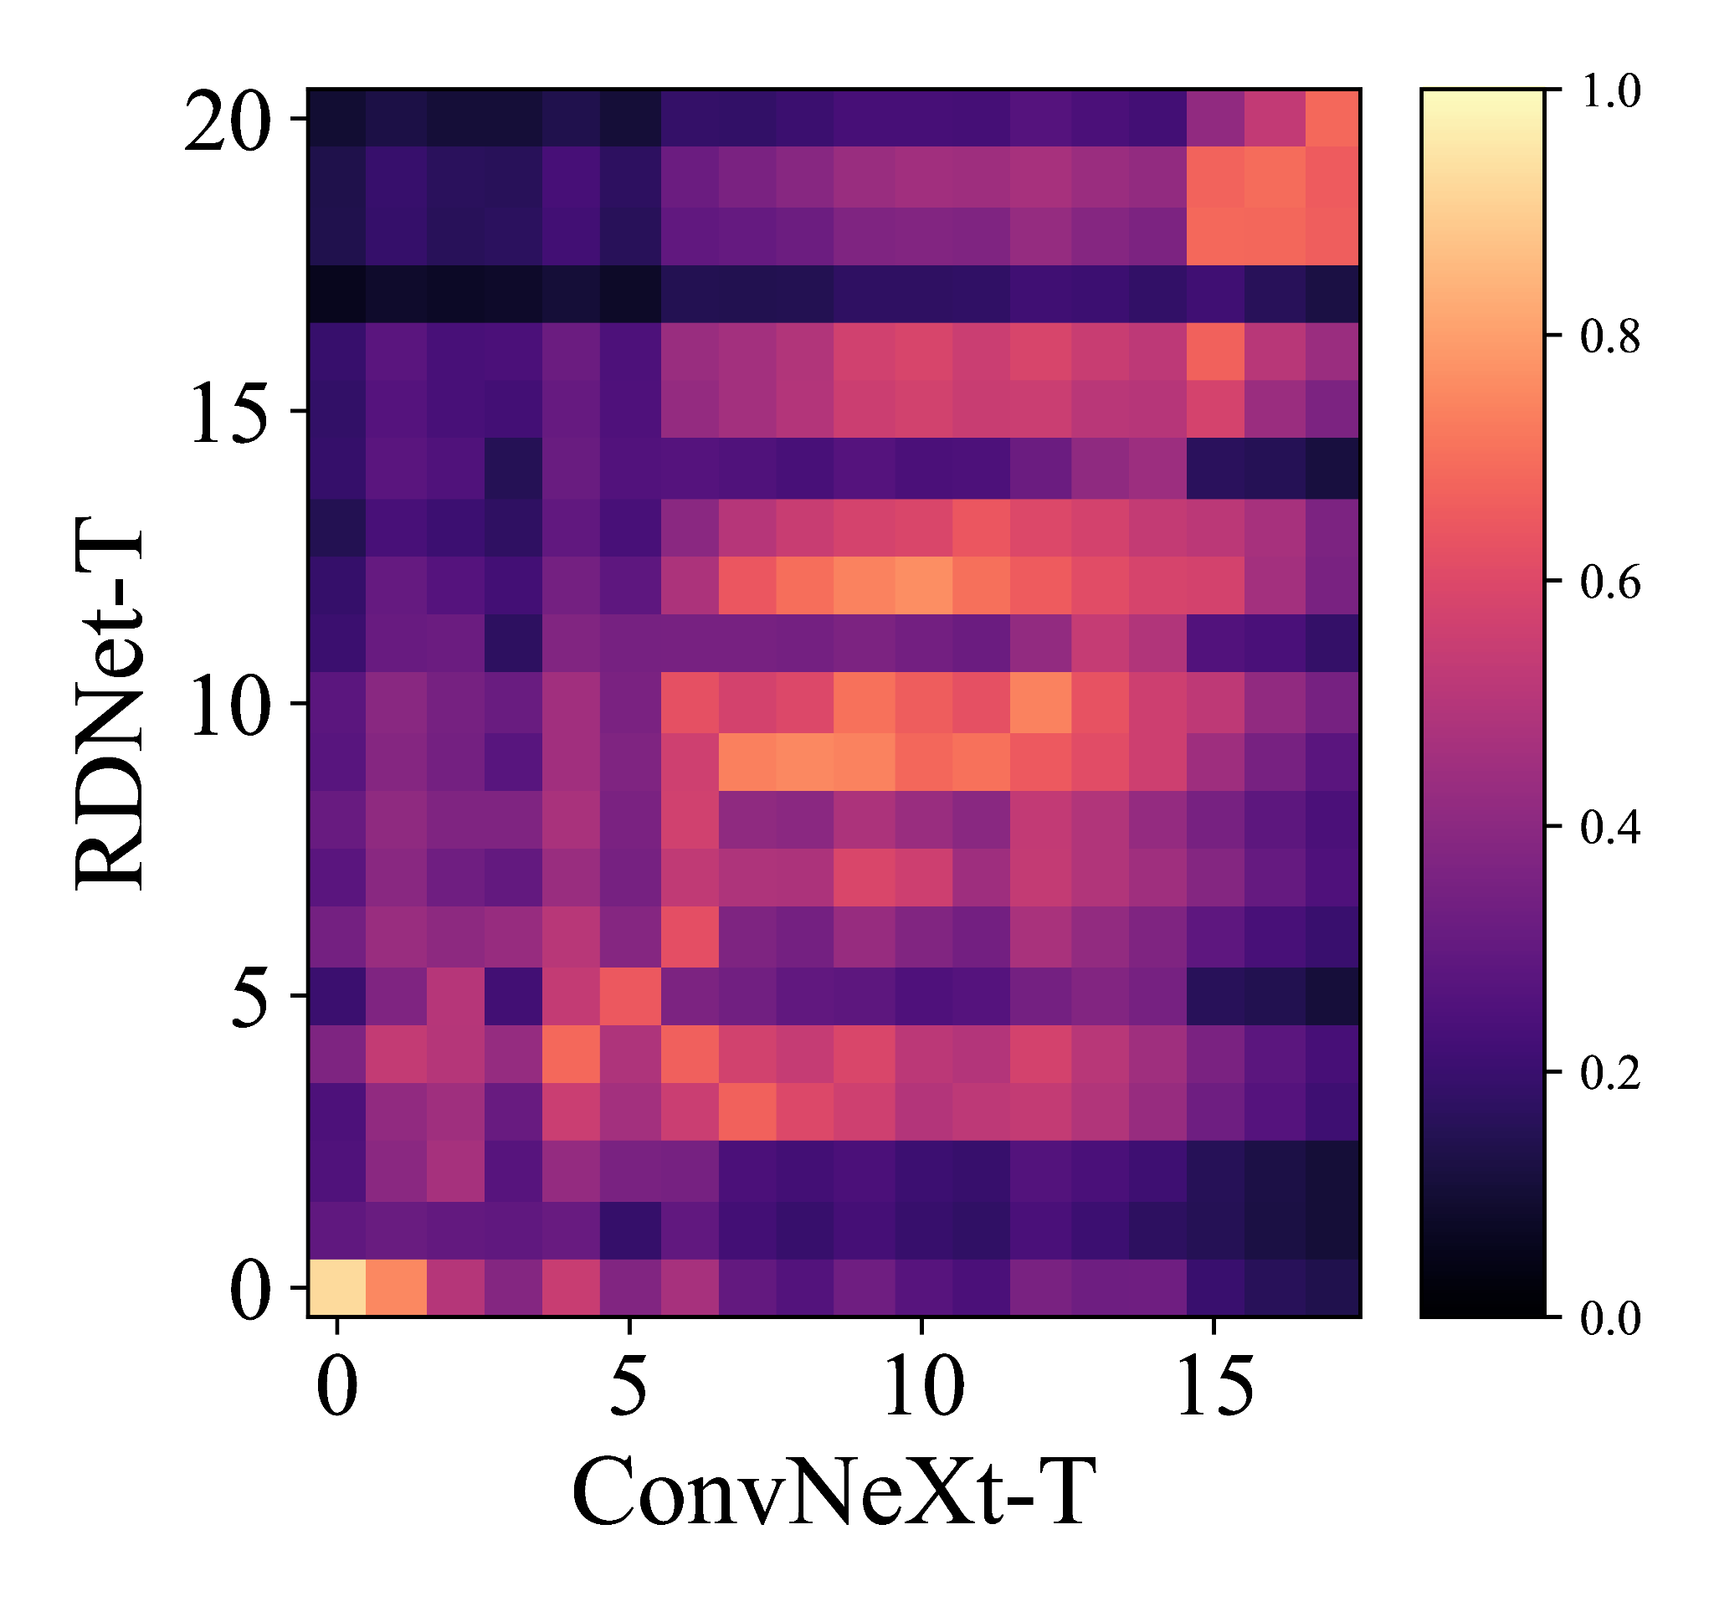
CKA Analysis
Centered Kernel Alignment (CKA) Analysis:
CKA analysis compares the similarity between two representations.
Features learned by RDNet are unique from the features learned by ConvNeXt-T.
1 = identical
0 = completely different

Slide 20
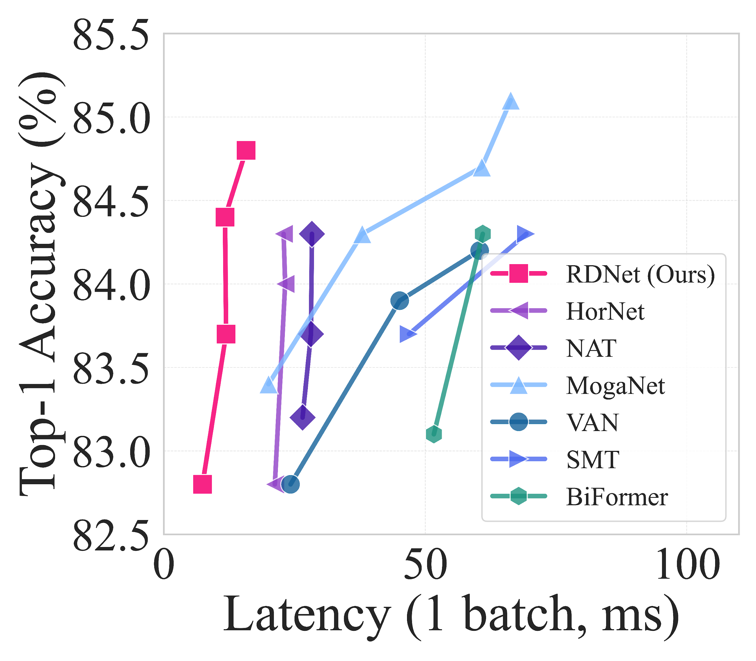
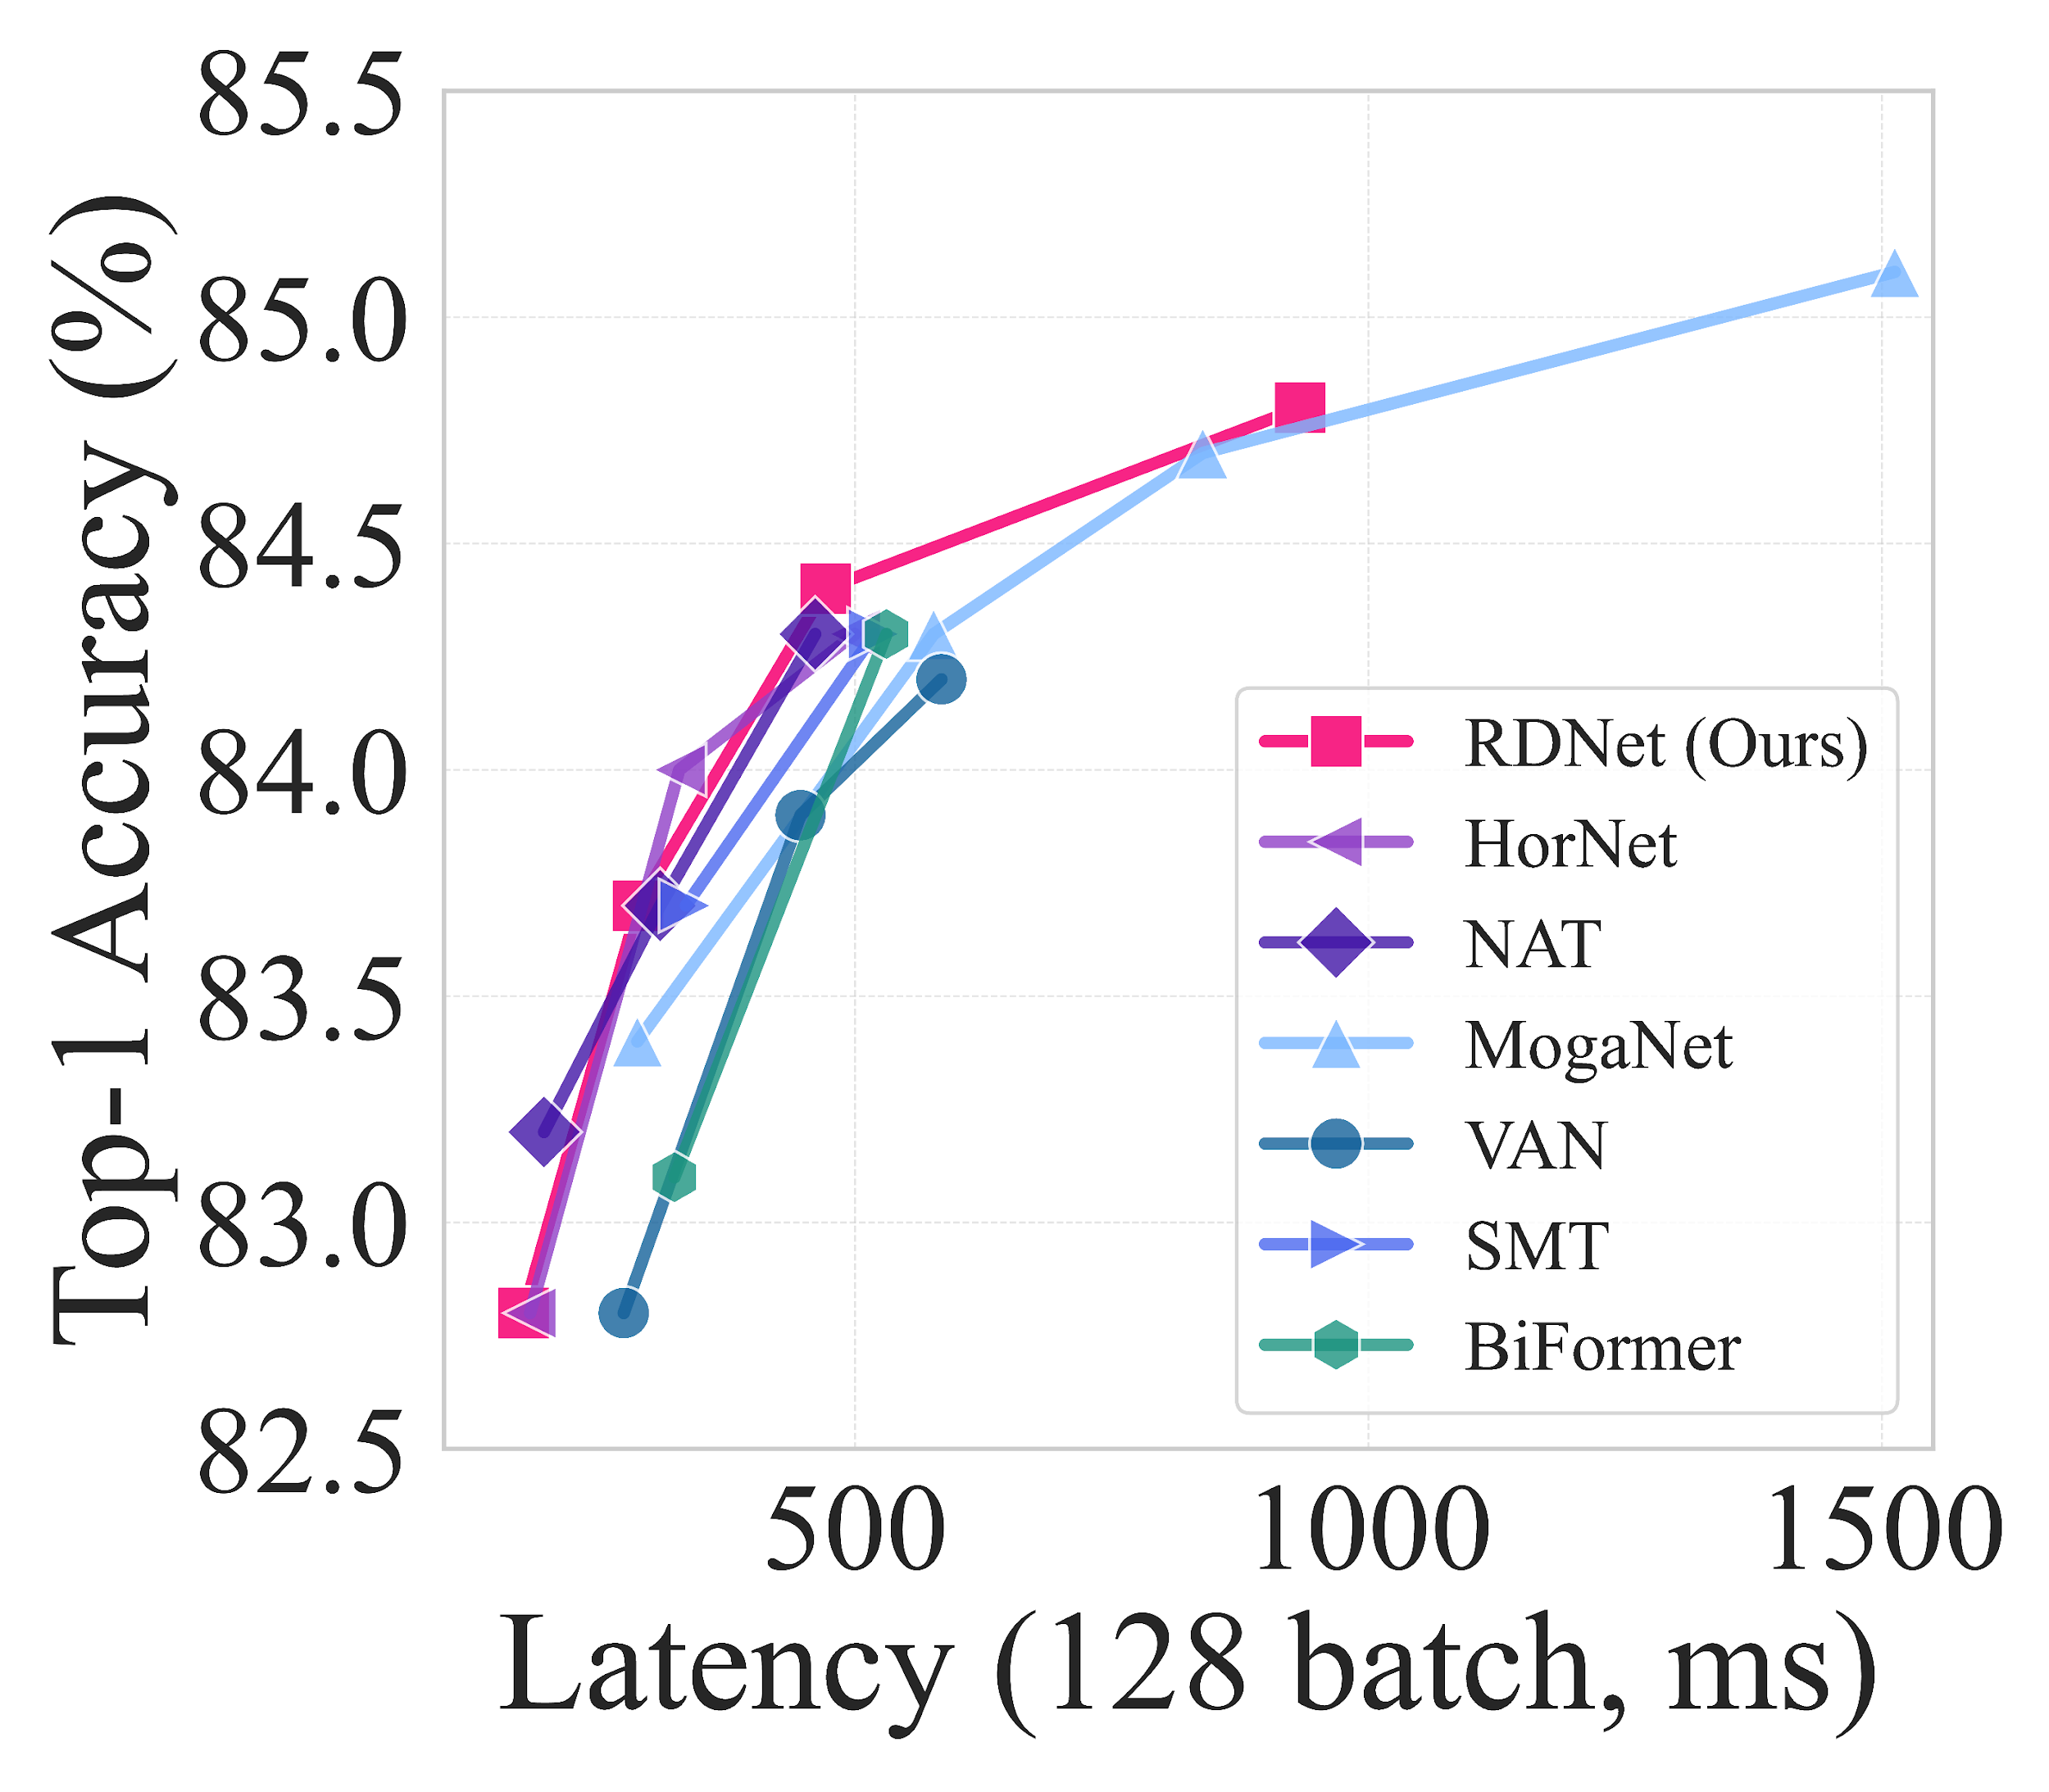
Comparison to State of the Art
Model Speed:
RDNet maintains competitive model speed, relative to similar state-of-the-art models.
Source: Kim, Donghyun, et al. DenseNets Reloaded: Paradigm Shift Beyond ResNets and ViTs. arXiv, 2024. DOI.org (Datacite), https://doi.org/10.48550/ARXIV.2403.19588.
Notes:
NVIDIA A100 GPU, Intel Xeon Gold 5120 CPU, and TensorRT Inference Engine PyTorch 1.13.1 and CUDA 11.6
Memory is measured in the training phase with a batch size of 16.

Slide 21
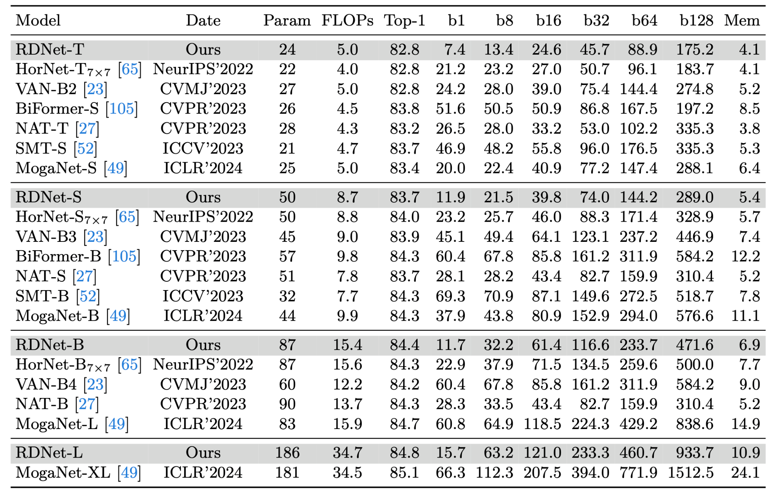
• RDNet-T:
GR = (64, 104, 128, 224),
B = (3, 3, 12, 3)
• RDNet-S:
GR = (64, 128, 128, 240),
B = (3, 3, 21, 6)
• RDNet-B:
GR = (96, 128, 168, 336),
B = (3, 3, 21, 6)
• RDNet-L:
GR = (128, 192, 256, 360),
B = (3, 3, 24, 6)
Source: Kim, Donghyun, et al. DenseNets Reloaded: Paradigm Shift Beyond ResNets and ViTs. arXiv, 2024. DOI.org (Datacite), https://doi.org/10.48550/ARXIV.2403.19588.
Notes:
The memory is denoted for batch size of 16 in last column of the above image. Added this to compare the memory requirements as compared to other sota models and also all of them have been pretrained from scratch using the imagenet 1k.

Slide 22
Plans for Final Project
Transfer learn RDNet to CIFAR 10
First, we plan to implement a RDNet for usage on the Image Classification tasks associated with CIFAR 10 dataset.
Adversarial Attacks Testing
Add in random noise and occlusions to determine the Robustness of RDNet, then compare this is a competitor model like ResNet.
Quantization (Stretch Goal)
Apply Quantization techniques to make model size smaller, determine the effects on model accuracy and performance.

Slide 23
Pros/Cons
Pros
Puts DenseNets on an even playing field with SOTA architectures
Sheds light on the advantages of using concatenations
Concatenation shortcuts surpass the expressivity of addition-based shortcuts
Cons
Limitations to scaling at even larger sizes

Slide 24
Q&A

Slide 25
Backup Slides

Slide 26
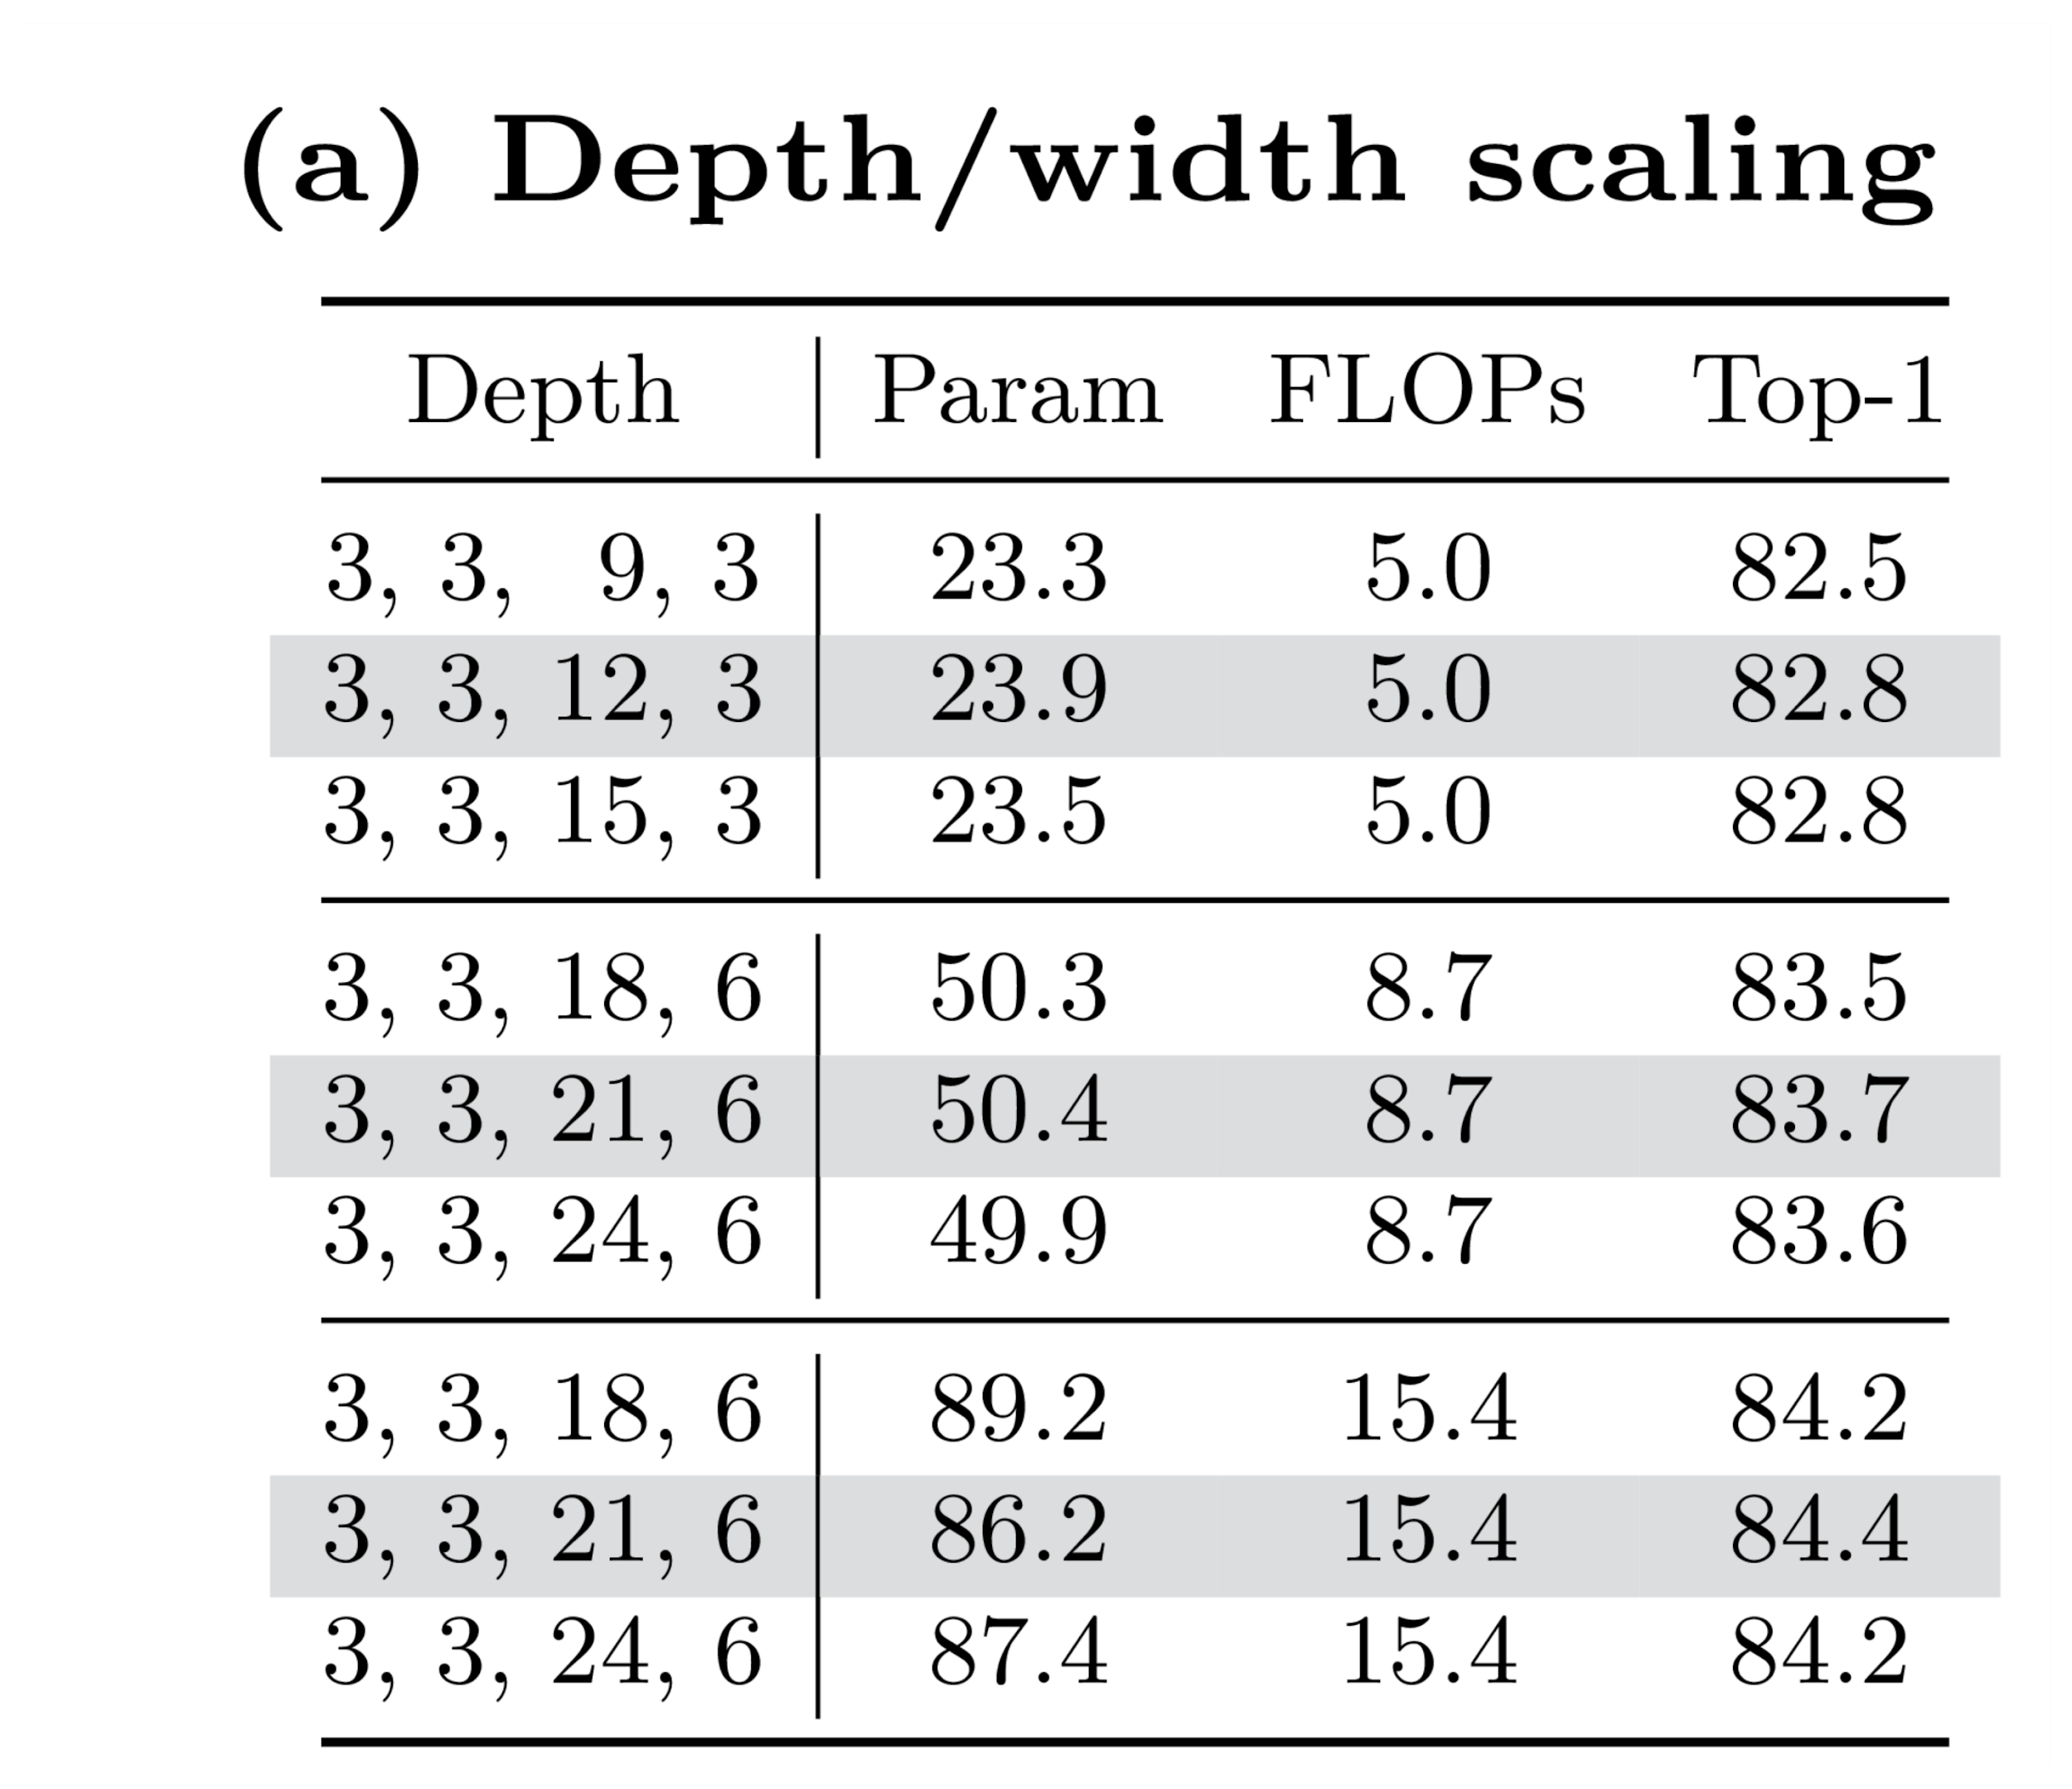
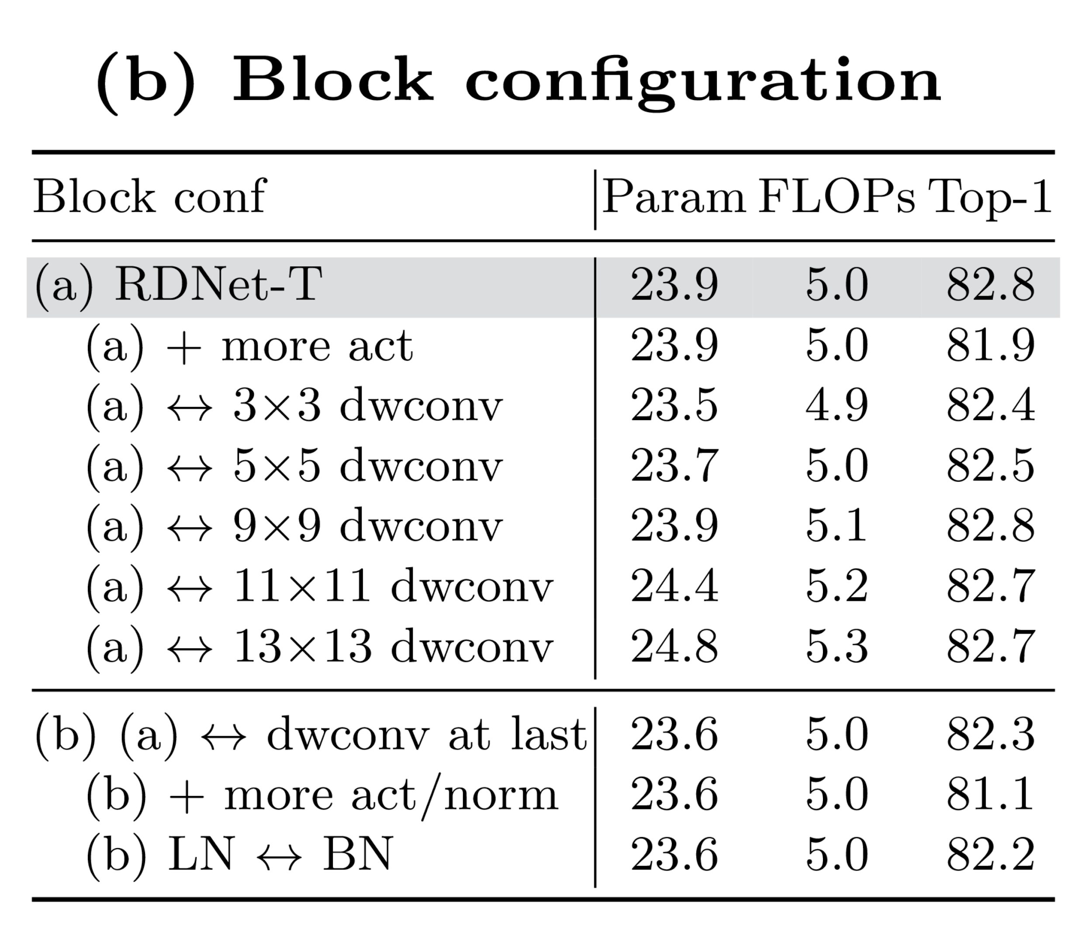
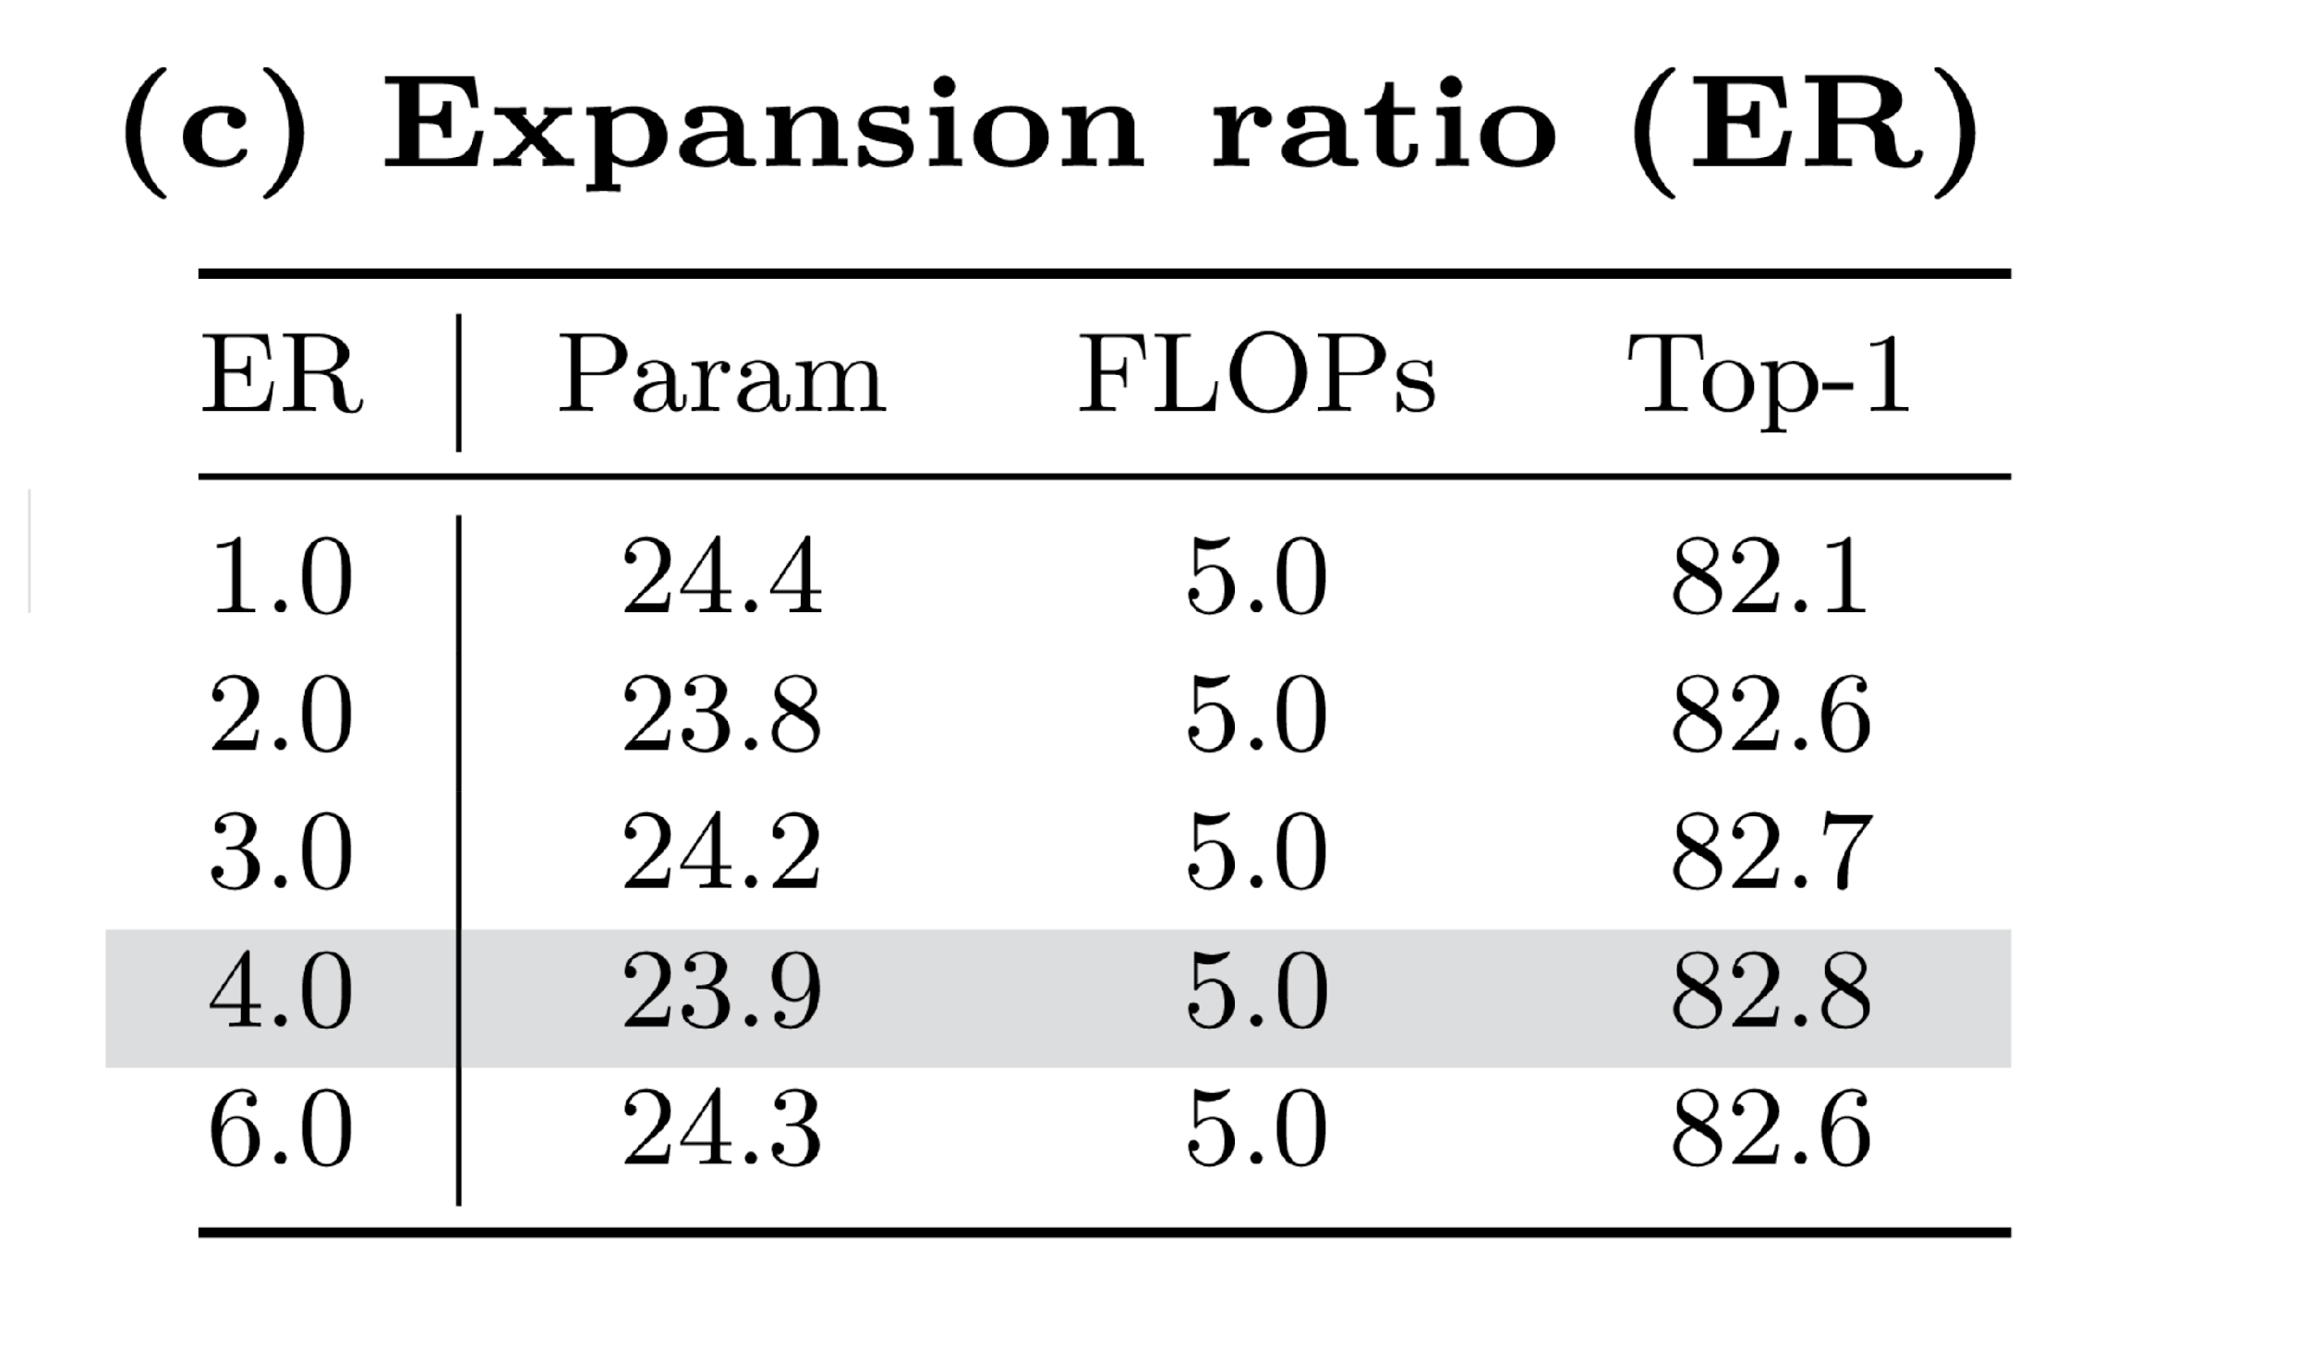
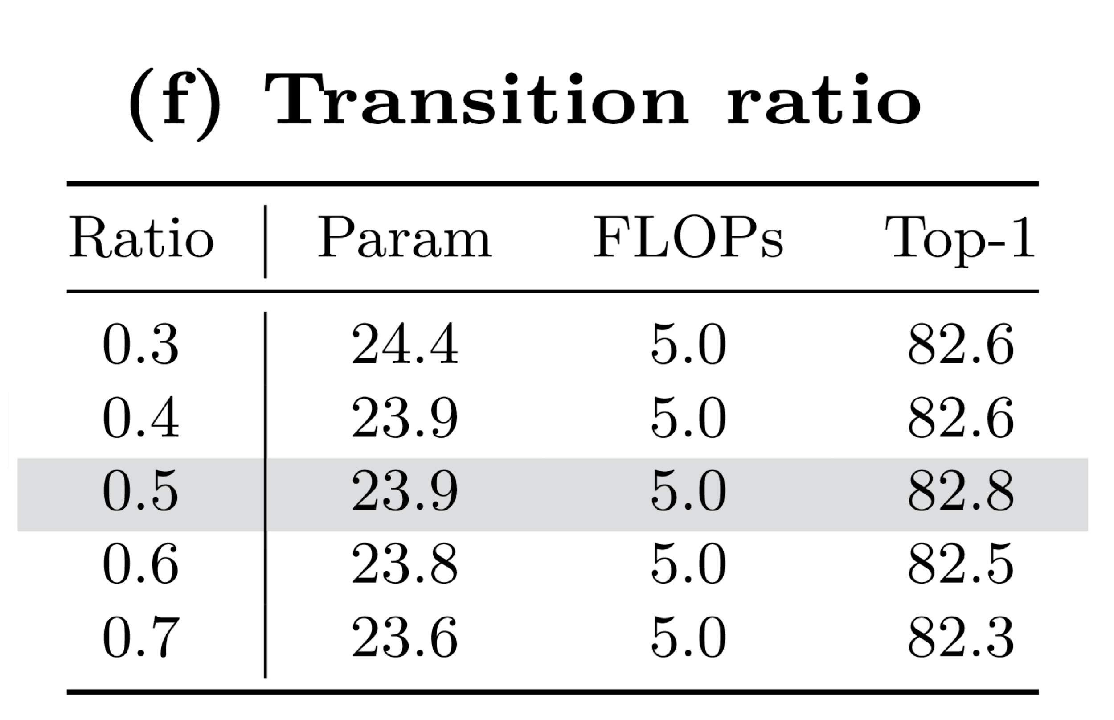
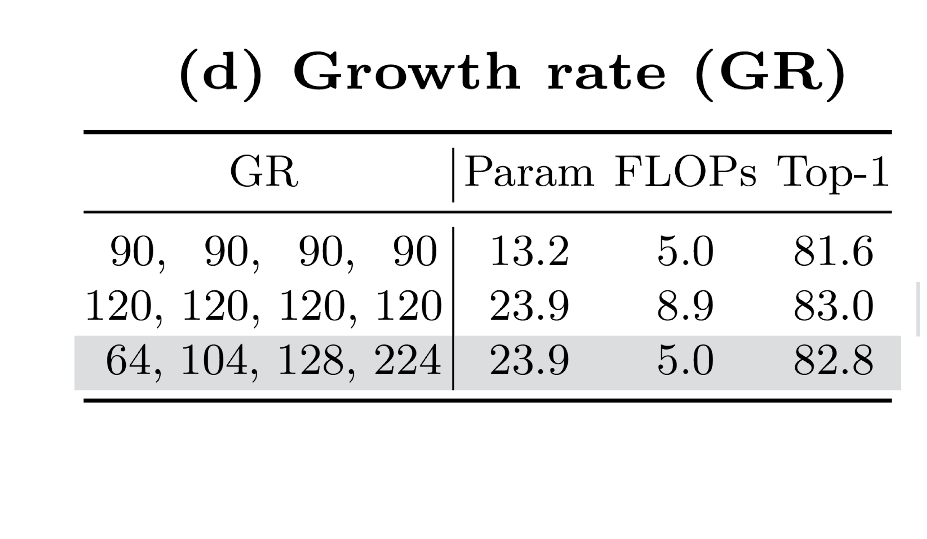
Ablation Study
Source: Kim, Donghyun, et al. DenseNets Reloaded: Paradigm Shift Beyond ResNets and ViTs. arXiv, 2024. DOI.org (Datacite), https://doi.org/10.48550/ARXIV.2403.19588.
Notes:
The transition layers between stages are intended to reduce the number of channels. Due to the dense connections in every block, the intensified accumulation of features does not allow a high growth rate (GR). They introduce a novel aspect using more transition layers to address it. To be specific, they propose to use a transition layer in a stage, not solely after each stage, but after every three blocks with a stride of 1. These transition layers focus on dimension reduction rather than down sampling.
We use the identical setup of a patch size 4 with a stride 4 for the patchificaiton.
Also the introduction of dynamic Growth Rate for each stage

Slide 27
DenseNet to RDNet
Growth Rate changed from 32 => 120
Layers(6, 12, 48, 32) => (3, 3, 12, 3)
Source: Kim, Donghyun, et al. DenseNets Reloaded: Paradigm Shift Beyond ResNets and ViTs. arXiv, 2024. DOI.org (Datacite), https://doi.org/10.48550/ARXIV.2403.19588.
Notes:
Here I focus on three most important features of RDNet that define its architecture.
For more transition layer the Increase in GR aims to address the overall low GR in the baseline at an architecture level, whereas the abovementioned GR decrease was to boost ER on a block level.
We investigate if channel re-scaling is required due to the
diverse variance of concatenated features. We examine our proposed re-scaling
approach,whichhasasimilarformulationbymergingthechannellayer-scale[76]
and an effective squeeze-excitation network [48]. Table 1(h) indicates it achieves
a slight +0.2%p improvement, albeit with very minor inefficiency

Slide 28
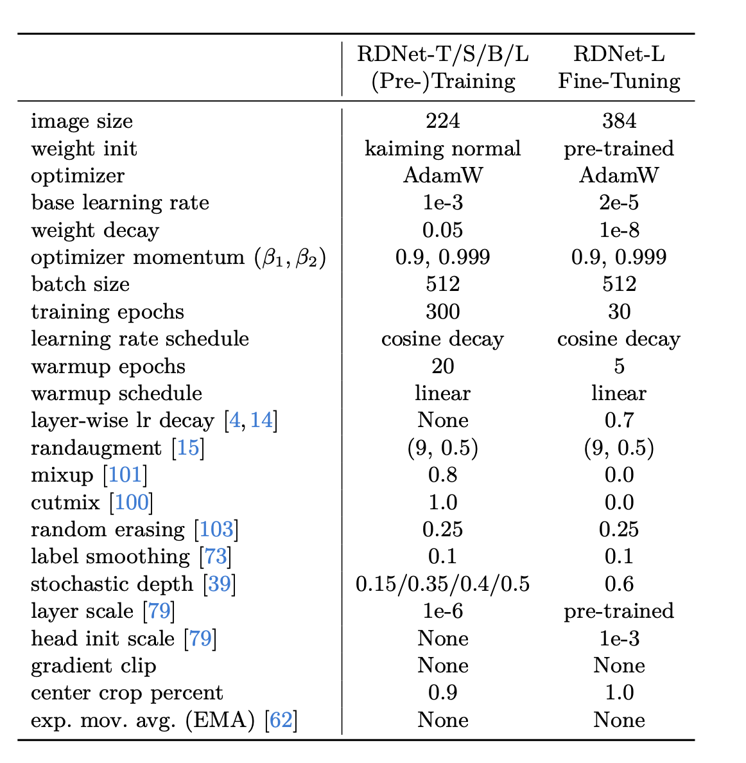
Training Setup

Slide 29
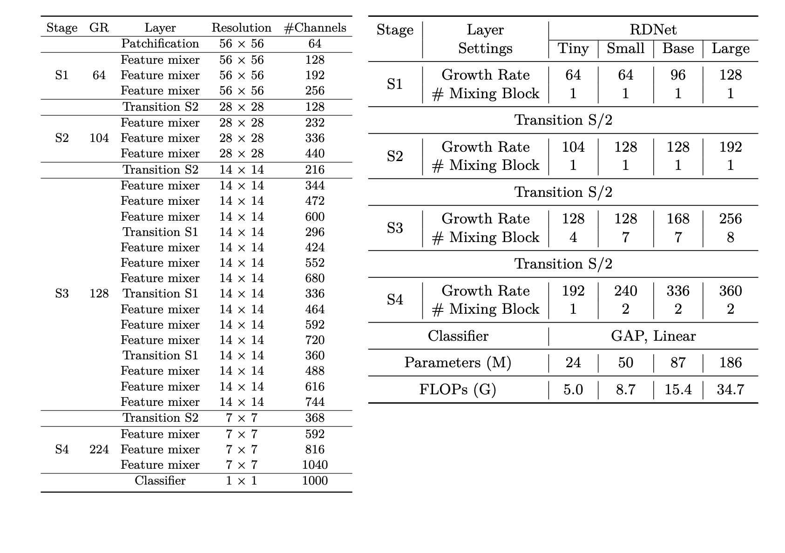
Model Configuration Setup

Slide 30
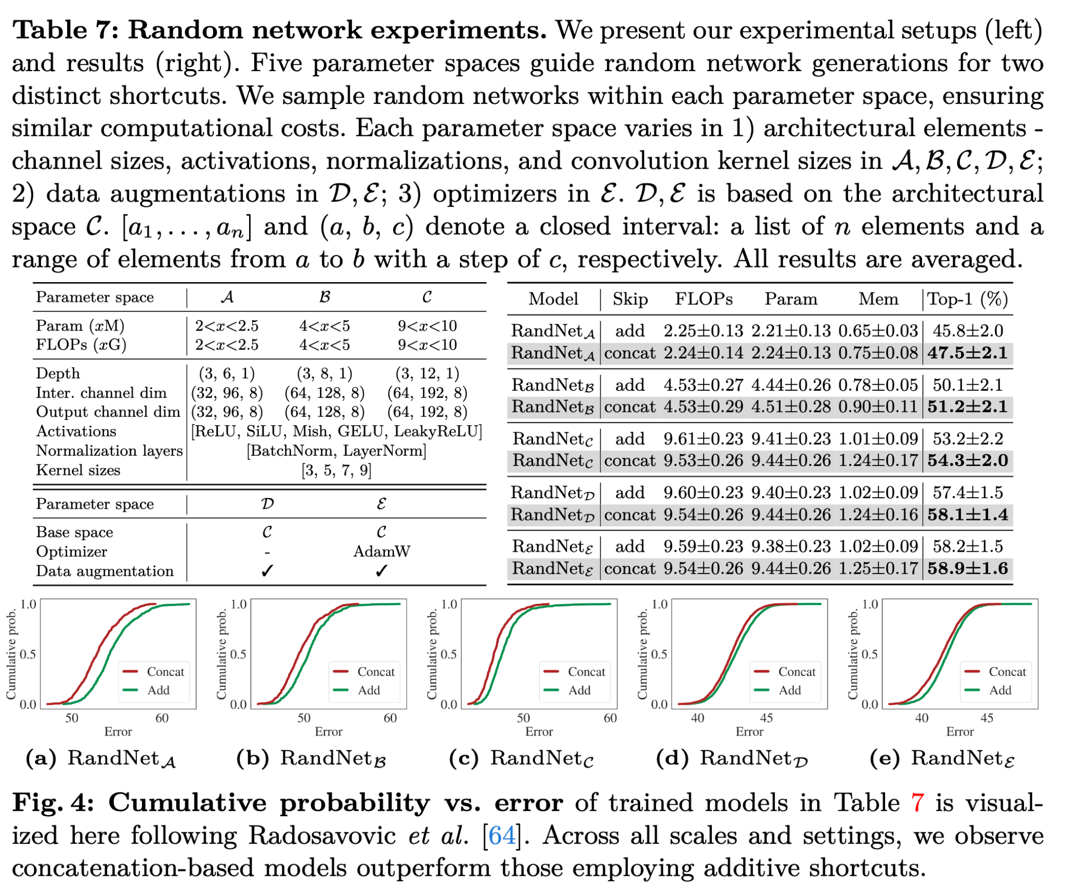
Random Network Experiments
Source: Kim, Donghyun, et al. DenseNets Reloaded: Paradigm Shift Beyond ResNets and ViTs. arXiv, 2024. DOI.org (Datacite), https://doi.org/10.48550/ARXIV.2403.19588.

Slide 31
Block Configuration and Feature Mixer
DenseNet Feature Mixer
Initial Feature Mixer
Source: Kim, Donghyun, et al. DenseNets Reloaded: Paradigm Shift Beyond ResNets and ViTs. arXiv, 2024. DOI.org (Datacite), https://doi.org/10.48550/ARXIV.2403.19588.

